Slide 1

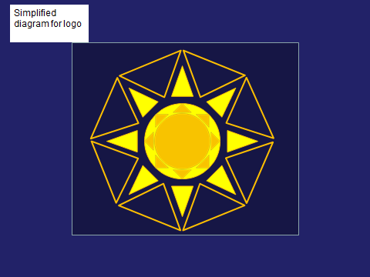

Further Action on Sustainable Tourism – Learning Areas Innovation Networks
(FAST-LAIN ) EU Project –
CIP Programme DG Enterprise 2011- 2012
Developing the Concept of a
Virtual European Tourism Observatory
for Sustainable and Competitive Tourism – Partners and Expert Group Overview

Slide 2
Contents
PART I
Conceptual foundations and topic management framework
PART II
Developing the Observatory Concept using the FAST-LAIN projects Learning Area approach
PART III
The DestiNet Portal – Simulating the Observatory Process in FAST-LAIN

Slide 3
PART I
The Observatory
Conceptual foundations and topic management framework
You can sit back and let this section play itself

Slide 4


Slide 5
Agenda 21
We are going to start with Agenda 21, but we will end up building a picture like this …
Original diagram -saved

Slide 6
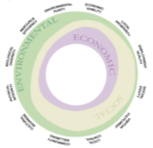
Climate Change, Energy & Resource Efficiency
Observatory monitoring and reporting on …
Competitive and Sustainable Tourism Processes created by tools to meet Topic Challenges
Processes that create competitiveness and sustainability …
Topics of interest …
Natural and Cultural Heritage
Governance, Destination Management
c
c
Command and Control Instruments
Certification, Marketing
Knowledge Networking, Training and Education
Measurement Instruments
Economic Instruments
Supply Chain Management
Supporting Instruments
Sustainable Travel and Transport
Voluntary
Instruments
Sustainable Consumption and Production
& Tourism
… and their territorial impacts
Original diagram -saved
Local
Regional
National
International

Slide 7
Agenda 21
Institutional development
Agenda 21
Lets go there !
Original diagram -saved

Slide 8
Institutional development
Economic
Original diagram -saved

Slide 9
Institutional development
Economic
Original diagram -saved
Environmental

Slide 10
Institutional development
Economic
Socio-cultural
Original diagram -saved
Environmental

Slide 11
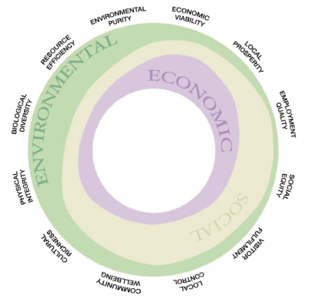
Institutional development
Economic
Socio-cultural
Original diagram -saved
Environmental

Slide 12

Sustainable Tourism Topic Framework
Original diagram -saved

Slide 13
Climate Change, Energy
Resource Efficiency
Original diagram -saved

Slide 14
Climate Change, Energy
Resource Efficiency
Natural and Cultural Heritage
Original diagram -saved

Slide 15
Climate Change, Energy
Resource Efficiency
Natural and Cultural Heritage
Governance, Destination Management
Original diagram -saved

Slide 16
Climate Change, Energy
Resource Efficiency
Natural and Cultural Heritage
Governance, Destination Management
Quality assessment,
Certification, Marketing
Original diagram -saved

Slide 17
Climate Change, Energy
Resource Efficiency
Natural and Cultural Heritage
Governance, Destination Management
Quality assessment
Certification, Marketing
Knowledge Networking, Training and Education
Original diagram -saved

Slide 18
Climate Change, Resource Efficiency
Natural and Cultural Heritage
Governance, Destination Management
Certification, Marketing
Knowledge Networking Training and Education
Supply Chain Management
Original diagram -saved

Slide 19
Climate Change,
Energy
Resource Efficiency
Natural and Cultural Heritage
Governance, Destination Management
Certification, Marketing
Knowledge Networking Training and Education
Supply Chain Management
Sustainable Travel and Transport
Original diagram -saved

Slide 20
Climate Change, Energy Resource Efficiency
Natural and Cultural Heritage
Governance, Destination Management
Quality Assessment
Certification, Marketing
Knowledge Networking Training and Education
Supply Chain Management
These topics give tourism stakeholders awareness of the opportunities and challenges that need to be addressed in policy and business
Sustainable Travel and Transport
Sustainable Consumption and Production
And Tourism
Original diagram -saved

Slide 21
Competitive & Sustainable Tourism Processes created by tools to meet Topic Challenges
Original diagram -saved

Slide 22
Sustainable Tourism Processes created by tools to meet Topic Challenges
Command and Control Instruments
Original diagram -saved

Slide 23
Competitive & Sustainable Tourism Processes created by tools to meet Topic Challenges
Command and Control Instruments
Measurement Instruments
Original diagram -saved

Slide 24
Competitive & Sustainable Tourism Processes created by tools to meet Topic Challenges
Command and Control Instruments
Measurement Instruments
Economic Instruments
Original diagram -saved

Slide 25
Competitive & Sustainable Tourism Processes created by tools to meet Topic Challenges
Command and Control Instruments
Measurement Instruments
Economic Instruments
Supporting Instruments
Original diagram -saved

Slide 26
Competitive and Sustainable Tourism Processes created by tools to meet Topic Challenges
c
Command and Control Instruments
Measurement Instruments
c
Economic Instruments
These processes need mapping measuring and monitoring to see how successful they are in meeting the opportunities and challenges
Supporting Instruments
Voluntary
Instruments
Original diagram -saved

Slide 27
c
c
c
c
c
c
Territorial Dimension of the Observatory
Original diagram -saved

Slide 28
c
Territorial Dimension of the Observatory
Original diagram -saved
Local

Slide 29
c
c
c
c
Territorial Dimension of the Observatory
Original diagram -saved
Local
Regional

Slide 30
c
c
c
c
c
Territorial Dimension of the Observatory
Original diagram -saved
Local
Regional
National

Slide 31
c
c
c
c
c
c
Territorial Dimension of the Observatory
To give the overall picture across Europe via a multi-level observatory …
Original diagram -saved
Local
Regional
National
International

Slide 32
Climate Change, Energy & Resource Efficiency
…monitoring and reporting on …
Competitive and Sustainable Tourism Processes created by tools to meet Topic Challenges
Processes that create competitiveness and sustainability …
Topics of interest …
Natural and Cultural Heritage
Governance, Destination Management
c
c
Command and Control Instruments
Certification, Marketing
Knowledge Networking, Training and Education
Measurement Instruments
Economic Instruments
Supply Chain Management
Supporting Instruments
Sustainable Travel and Transport
Voluntary
Instruments
Sustainable Consumption and Production
& Tourism
… and their territorial impacts
Original diagram -saved
Local
Regional
National
International

Slide 33






Now we can match the stakeholders to the observatory knowledge base …
The European virtual Tourism Observatory
To create informed multi-stakeholder
dialogue and harmonized work flows
NGOs
Original diagram -saved

Slide 34


To exchange and transfer knowledge on good practice
The European virtual Tourism Observatory
NGOs
Original diagram -saved
and market-place activity…

Slide 35
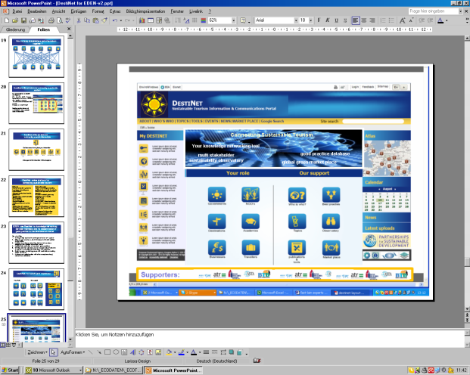




… creating the Virtual European Tourism Observatory, piloted in the DestiNet Portal

Slide 36
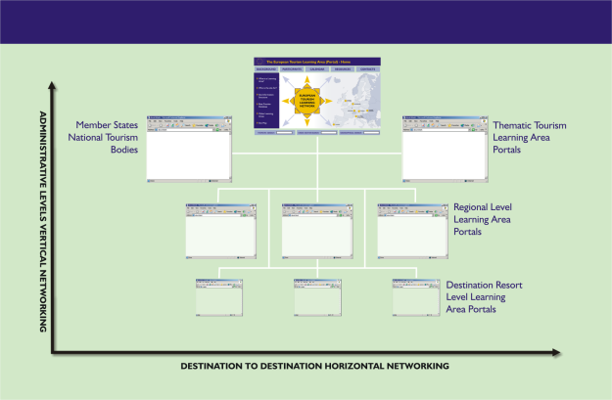
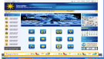
Virtual Tourism Observatory – aggregated from the local destination level to the European Level – a decentralized work flow behind the on line clustered coherence. Each member state, each European region, each destination sharing the system
How should it be structured?
The European Virtual Tourism Observatory
European-wide Tourism Learning Area
Network Structure

Slide 37
Implementation of the decentralised observatory model –
A collaborative approach to knowledge management based on partnership agreements that build up the observatory as a European mosaic is the most feasible way such an observatory would come in to being.
The mosaic would include the following organisations based on existing or new partnership arrangements with institutions such as:
Global Level: UNWTO, OECD, UNEP, WRI, GRI, GSTC, DestiNet
European level: EC Directorates, Eurostat and EEA
National Level –Member states statistics departments, economics, tourism and environment ministries
Regional Level – coordination body , tourism development, statistical collection and marketing agencies
Tourism Destinations – DMO, administrative and business networks, NGOs, consumers/travellers.

Slide 38
Financing the implementation process within the EU budget mechanisms
Top down implementation
Eurostat have a long history of collaboration over statistical collection with member states. This now needs a Commission wide review of statistical procedures that allows the latest ICT developments to improve the availability and timeliness of data flows from the regions to the centre and vice-versa.
Together , key directorates in the Commission can work towards directing structural funds and regional development budgets to such a programme, as it will need a large scale resource injection to move to this decentralized model.
Bottom up Implementation
However ,when approached on a regional or country by country basis, the mosaic can still be built within budgetary restrictions of national and regional statistical reporting systems related to research, publicity and marketing budgets.

Slide 39
Now, its time to work out how to do all this.

Slide 40
PART II
Developing the observatory concept using the FAST-LAIN project’s Learning Area approach
(Manual slide advancement)

Slide 41




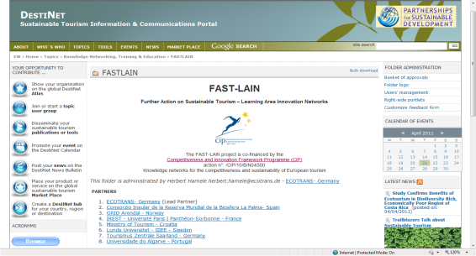










FURTHER ACTION ON SUSTAINABLE TOURISM
LEARNING AREA
INNOVATION NETWORKS
DestiNet
FAST-LAIN

Slide 42
Measuring Competitive, Responsible and Sustainable Tourism
in Europe – the FAST-LAIN Project

Slide 43
What do we need to observe, how do we observe it and other key overlapping questions?
?
What is its mission statement and scope?
How should it be structured and operated?
?
Who are the stakeholders who have an interest in such an observatory?
What information should it contain , and how will it present the information?
How can we afford to do this, and who should pay for setting it up and running it?
What existing processes can it be linked to in order to avoid duplication and develop synergy?
What will be its work programme?
?

Slide 44
FAST-LAIN Thinking …
… we need to design a virtual observatory for mapping, measuring, monitoring and reporting on European tourism development processes in a global economy …

Slide 45
FAST-LAIN Thinking …
This is a concept for a European-level, virtual tourism observatory -
Its primary focus is to observe and report on the competitiveness and sustainability of European tourism destinations and businesses …

Slide 46
FAST-LAIN Thinking …
There is a need to measure processes which lead to more sustainable tourism.
A European-level observatory can incorporate observation and reporting on the overall policy cycle, ie from EU to local administrative policy, programmes, projects, products and services and their collective impacts on the European territory.

Slide 47
FAST-LAIN Thinking …
In recognition of the role of the observatory in research to marketplace knowledge transfer, the reporting processes from the observatory should meet the learning needs of all European stakeholders

Slide 48
FAST-LAIN Thinking …
The virtual aspect of the observatory allows the concept to be highly decentralised with multi-level networked processes to achieve greater accuracy, improved stakeholder relevance and lower centralised costs.

Slide 49
Modelling the Virtual Observatory – Overview of Scope
Monitoring and Reporting on the
Policy to Practise Cycle
Supply Chain and Destination …
… Physical and Human Resource Base
UN Policy
EU Policy
Member State Policy
Regional Policy
Local Government Policy
Corporate Policy
Legislation and Programmes that affect travel and tourism activity
economic, environmental,
socio-cultural and institutional impacts on the European territory
… Physical Infra-structure and Human Capital investment
… Market Place Activities

Slide 50
Observatory Processes: specific attributes of measuring
tourism policy to practise
A European-wide observatory system monitoring & reporting system of overall tourism performance of EU member states and its regions, taking in policy development and market place activities for a range of stakeholders including: EC and other EU institutions, and European destinations and businesses, researchers, consultants, media, travellers and host communities.
Developed within the existing framework of UN Agenda 21/EU SDS policy and Member state impact monitoring and statistical collation systems.
Specifically tailored to delivering the 2011 EU legislation for member states to develop more detailed tourism data collection.
Specifically tailored to research, innovation, competitiveness and sustainable consumption and production policy
Linked to Eurostatt, DG Enterprise, DG Regio, DG Environment and DG E&C DG Transport and the Sec Gen for supply chain and for territorial impact analysis
Taking advantage of internet to create multi-level, bottom up data collation and centre-periphery administrative work flows and knowledge transfer mechanisms

Slide 51
Observatory Processes: Input –output attributes for developing the information work flow of the system
INPUT
Establish operational protocols for horizontal and vertical administrative communication and work flows
Develop horizontal, sectoral and thematic linkages at all administrative levels to gather and report information to the vertical information work flow
Develop vertical coherence in information design and gathering processes
OUTPUT
Provide a common internet knowledge base and information network for interested parties
Deliver timely, credible and verified information
Provide information according to stakeholder learning needs
Develop a historical knowledge base of empirical analytical and subjective data

Slide 52
Observatory Outputs
A virtual European Sustainable Tourism Observatory would deliver information and knowledge via a European-level web portal linked to other observatories, and a system of national and regional gateways and outposts.
This system would give users access to:
A statistical European-wide data-bank on tourism development
Monthly, quarterly and annual reports, special reports etc…
eNewsletters and web postings with data interpretation and strategic analysis
Special interest forums on observatory topics
A catalogue of evidence-based good practice
These reporting outputs would be designed to
meet the needs of each stakeholder grouping ….

Slide 53
Virtual Tourism Observatory – aggregated from the local destination level to the European Level – a decentralized work flow behind the on line clustered coherence
How should it be structured?
The European Virtual Tourism Observatory
European-wide Tourism Learning Area
Network Structure

Slide 54
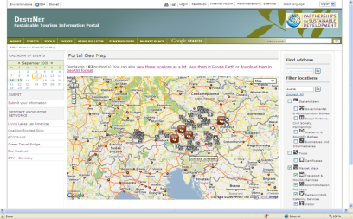
Building Regional Information Clusters for the Observatory
The European Virtual Tourism Observatory
European-wide Tourism Learning Area
Network Structure
Virtual Tourism Observatory - Vienna
To improve local accuracy and relevance, the vertical information flow needs to be fed by horizontal information clusters where the common link between stakeholders is either a specific territory or a specific topic.

Slide 55
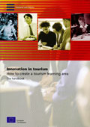
Clustering stakeholders in an observatory process to meet their learning needs
Destination Learning Areas and Topic Learning Areas
The (Life-long) Learning Needs of stakeholders in clusters are best met through the concept of the Destination and Topic Learning Areas, focused on tourism competitiveness and sustainability. The observatory feeds into and feeds off the information flows in these Learning Areas
Learning systems
Formal
Non formal
informal
Life Long Learning processes for tourism development, met by in part by observatory outputs, and providing data for the European-level observatory, organized at the national and regional level

Slide 56
The Observatory as a Decision Support System - Process and performance measurements for each Topic & Destination Learning Area
Stakeholder relevant reporting systems
Topics defining the challenges and opportunities of sustainable tourism development
Observatory data
Destinations, regions countries, businesses and consumers meeting the challenges and opportunities
Policy & Business Tools used to meet challenges and take opportunities
Sustainable Tourism Processes using the tools
Performance indicators for each process

Slide 57
The Observatory as a Decision Support System - Process and performance measurements for each Topic & Destination Learning Area
A fundamental principle of policy-relevant development of observatory data should be to assist national and regional authorities - and businesses – to meet contemporary challenges by defining a set of sustainable development processes whose implementation by these stakeholders should be measured by performance indicators that demonstrate competitive and sustainable development has occurred.

Slide 58
Observatory Reporting System - process and performance measurements for each Topic and Destination Learning Area
Each policy belongs to or generates a variety of processes relevant to sustainable tourism. Performance indicators should logically feed back to decision takers. The observatory can accomplish this by setting up a Process and Performance Reporting System related to the policy cycle.
The processes would have an accompanying set of performance indicators that could be used to establish trends over time, e.g. PROCESS - uptake of Local Agenda 21: PERFORMANCE - number of certified businesses
The observatory would map such processes and their indicators, allowing the observation of both the sustainable development of tourism and the use of tourism for sustainable development.

Slide 59
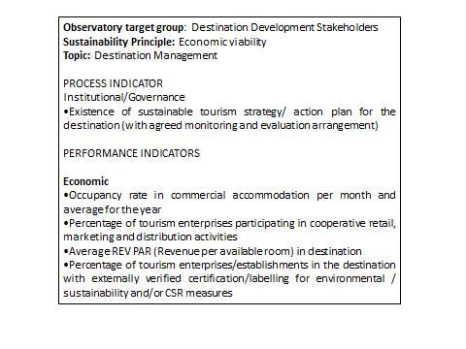
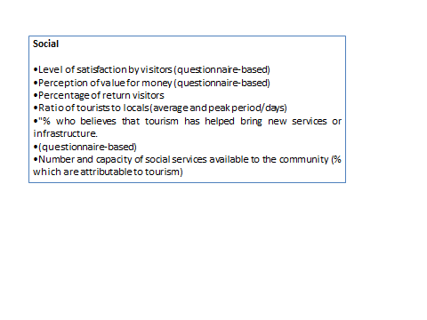
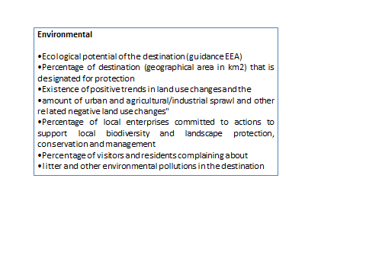
Virtual Sustainable Tourism Observatory - Process and Performance Reporting System
This can now be exemplified by the following example of destination development indicators that would typify observatory content tailored for destination managers:

Slide 60
Who are the stakeholders who have an interest in knowledge produced by such an observatory process?

Slide 61
What do they need to know?
What do they need to know?
News & events
Meeting the Learning Needs of stakeholders in order to
promote more competitive and sustainable actions

Slide 62
Bring them together in the Destination Learning Area …
… sharing the common observatory knowledge base …
Best Practice
other
The Destination Learning Area
… to promote innovation
quality competitiveness responsibility and sustainability
… A round table for
multi-stakeholder collaboration ..
NGOs
Market-Place

Slide 63
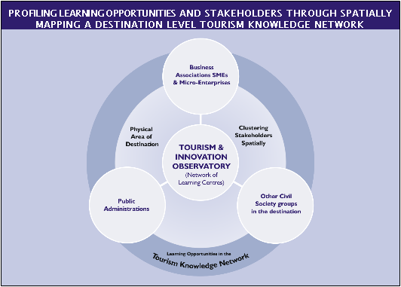

The Destination Learning Area (DLA) as a component part of a de-centralised, networked European-wide process of tourism observation
The Destination Learning Area

Slide 64
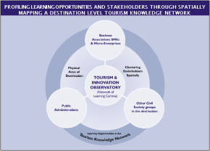
The Destination Learning Area (DLA) as a component part of a de-centralised, networked European-wide process of tourism observation

Slide 65
… creating the Virtual European Tourism Observatory

Slide 66
Summary - a multi-level knowledge transfer system for European sustainable tourism stakeholders
The network shape – a decentralized set of local, regional, national and international component organisations working together as part of a European multi-level observatory networking process
Each sub set of component organisations can be structured as a Learning Area, clustering together the appropriate stakeholders at each level for the purpose of information gathering and knowledge sharing, using Eurostat as the skeletal statistical form, related to national & regional data collation and indicator systems.
Thematic Topics based on Agenda 21 and sustainable tourism policy and business principles will shape the reporting process according to stakeholder learning needs
The observatory will deliver process and performance reporting systems for innovation, quality, competitiveness and sustainability.

Slide 68
PART III
The DestiNet Portal
Simulating the Observatory Process in FAST-LAIN Project using the DestiNet Sustainable Tourism Portal

Slide 69
DestiNet in the FAST-LAIN - simulating the observatory work flow
To field test the observatory concept, the FAST-LAIN project has taken the related the work of the European Research Area to the observatory process. This has created the sustainable tourism topic framework , to which the portal adds a territorial framework, in which knowledge transfer between tourism stakeholders can take place.
In order to develop the portal knowledge base in terms of key issues facing these stakeholders, each topic will provide a topic learning and reporting process relevant to each stakeholder group according to their information preferences.
You can visit the DestiNet site to see how an example of how this observatory concept can be ordered using the Destinet Partnerships global to local EU/UN developed ICT system. www.destinet.eu

Slide 70
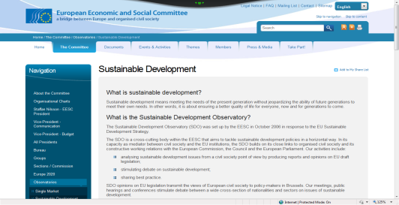
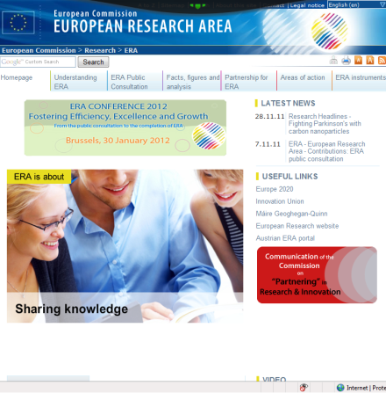
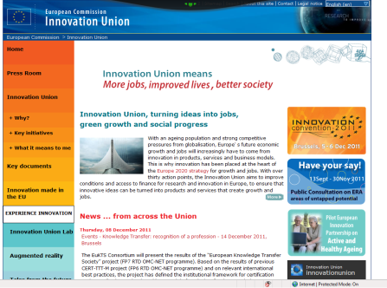
EU-level policy and organisational links for the observatory
Eurostat base
DG Enterprise – Directorate & Policy Coherence:
Env, Regio, Training Education &Culture,
Commissions’ Sec Gen SDS Implementation and Competitiveness & Innovation policies
EEA service
European Research Area
Non EU bodies
European Travel Commission
Multi-stakeholder representational organisations
Thematic Organisations with a European coverage

Slide 71
Global Level Information Networking – linking European initiatives to existing international observatory processes
GRID Arendal
OECD
-UN - CSD Reporting Process for the EU (Rio +20)
-UN Conventions on Biodiversity, PoPs, Desertification Local Agenda 21 implementation

Slide 72
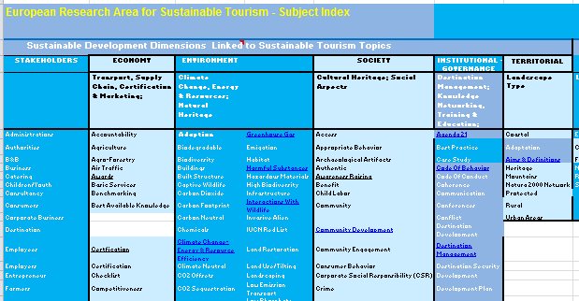
These institutions and processes provide the basis for the development of the subject index framework for a virtual observatory

Slide 73
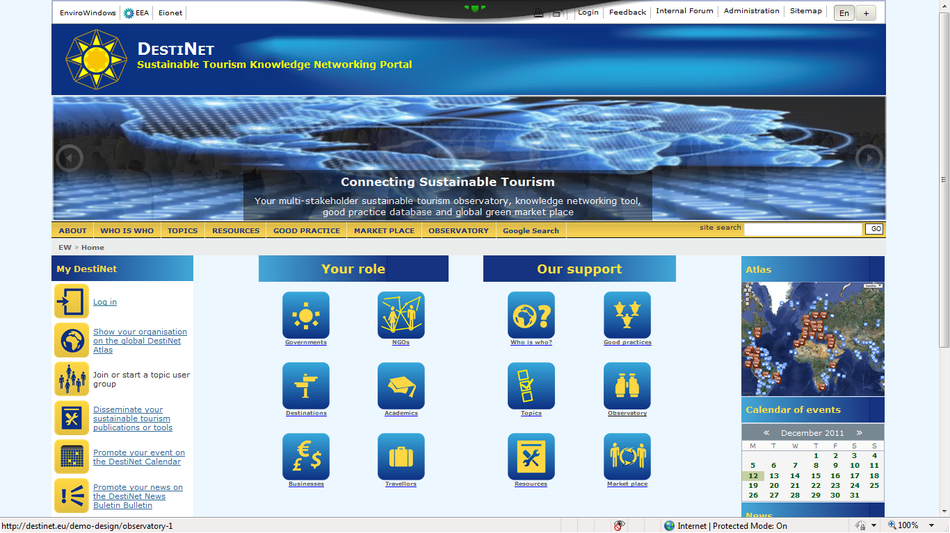
The Tourism Research Framework provides the subject matter for an observatory geared to catalogue and disseminate sustainable tourism knowledge and good practice

Slide 74
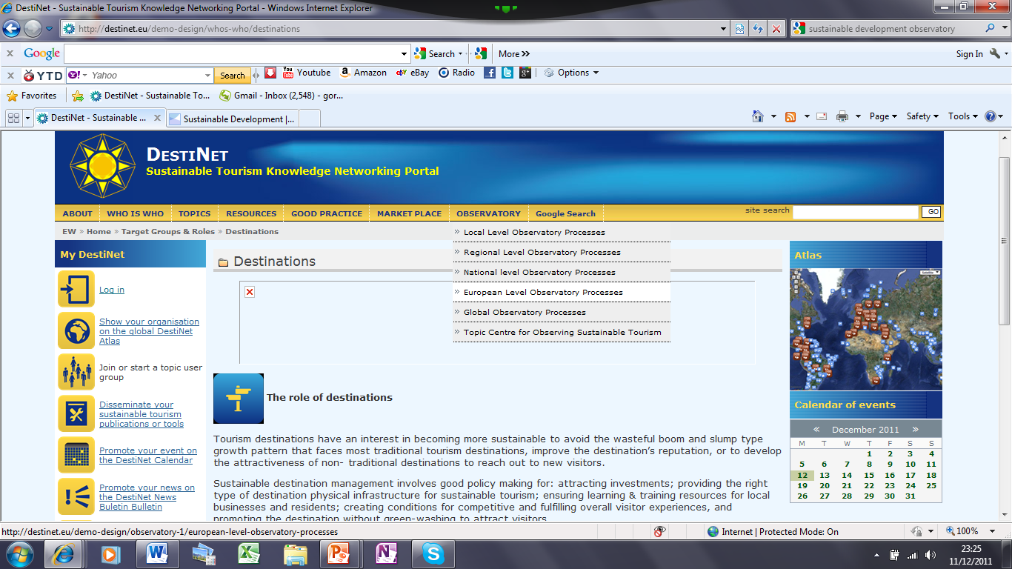
The Observatory – DestiNet has created a stakeholder friendly entrance to the observatory knowledge base

Slide 75
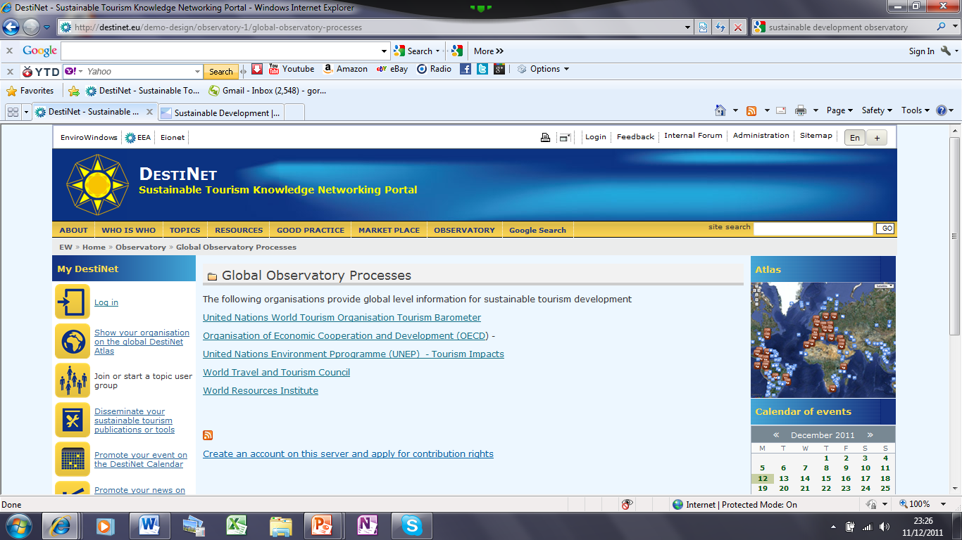
The Observatory - Giving Virtual Access to Multiple Data Sources

Slide 76
Final Summary and Conclusion
You should now have a clearer idea of the European virtual tourism observatory.
You have seen how Agenda 21 provides the basis for observatory subject matter, using a topic research framework that meets the global opportunities and challenges faced by European destinations, businesses and citizens, establishes tools and processes to face those challenges and opportunities, and passes on that topic knowledge via a virtual multi-level territorial information gathering and distribution system.
Once information is aggregated at the European-level, knowledge transfer – reported in relevance and language appropriate to each stakeholder - in turn virtually cascades from the centre to all European administrations, destinations, businesses and finally the travellers themselves
This presentation has explained the way the FAST-LAIN project is developing the ICT tools to simulate this. The DestiNet Portal has been designed as an online multi-stakeholder tool to operate Destination and Topic Learning Areas - horizontal knowledge networks - that feed into the vertical information flow required by the observatory.

Slide 77


Thanks for taking the time to watch this presentation. Now please open the Word document entitled
FAST-LAIN Observatory Concept
Partner Region and Expert Feedback Form.docx
to answer our questions about the concept and let us know what you think.
When completed, send it back to to herbert.hamele@ecotrans.de
Gordon.destinet@ecotrans,de
www.destinet.eu
This concept presentation was prepared by Gordon Sillence

