Slide 1
ECOTRANS: our long historical perspective on sustainability in tourism

Slide 2
WHY MAKING TOURISM MORE SUSTAINABLE?
„In future, our main concern will no longer be
whether we can travel to every place on earth.
Our main interest will be
whether it is worthwhile arriving there“
(Herrmann Löns, 1908)

Slide 3

making tourism more sustainable
Ecology
Transparency
Economy
Transfer

Slide 4

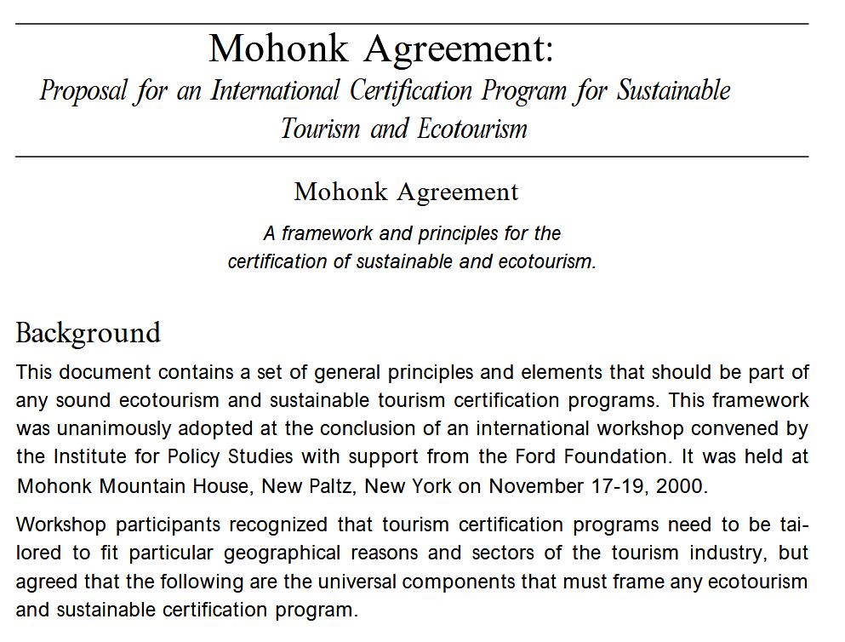
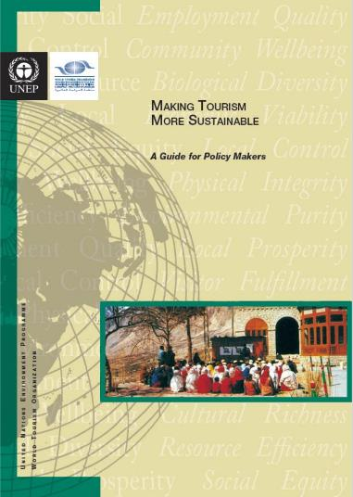
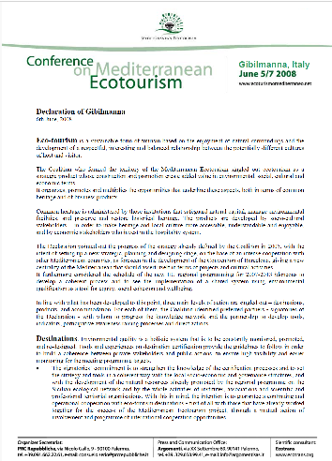
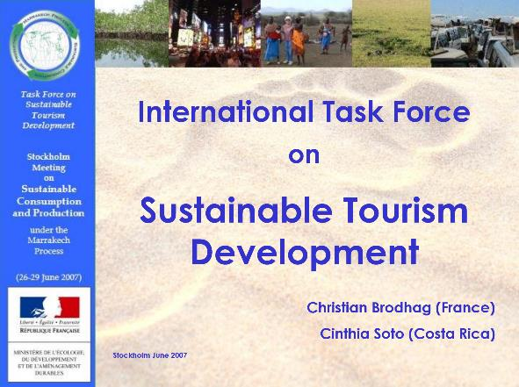

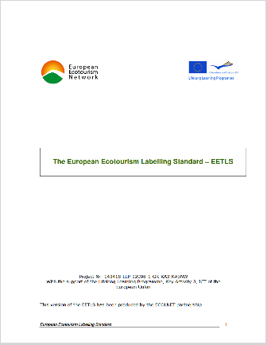
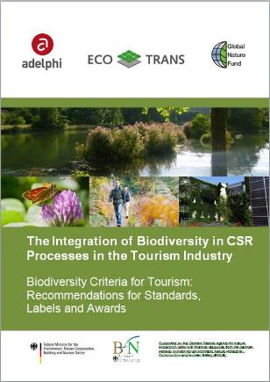
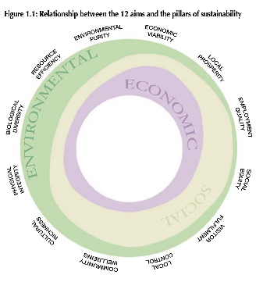
ECOLOGY: What shall be achieved?
Sustainable Tourism …
e.g.
1995: WCST Lanzarote
2000: Mohonk Agreement (USA)
2005: UNEP,UNWTO: Making Tourism More Sustainable
2008: Ecoturismo Mediterraneo
2007 – 2009: UN Task Force ST
2010: GSTC: Global Standards
2012: EEN: EETLS
2014: Biodiversity Criteria
… is well defined!
Sustainable management
Socioeconomic impacts
Cultural impacts
Environmental impacts
(including consumption of resources, reducing pollution, and conserving biodiversity and landscapes)

Slide 5
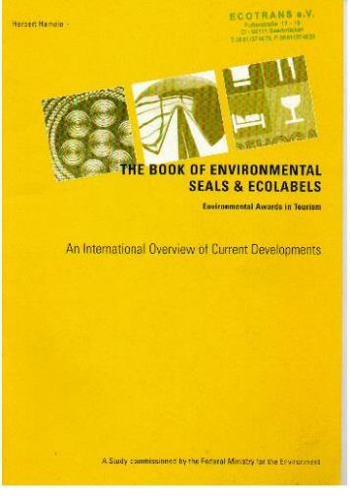
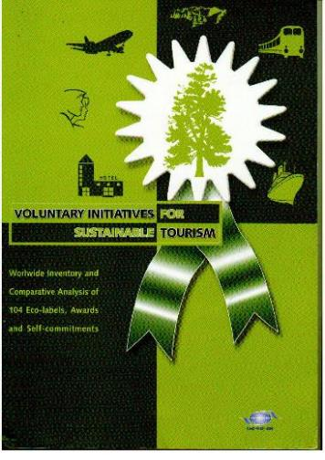

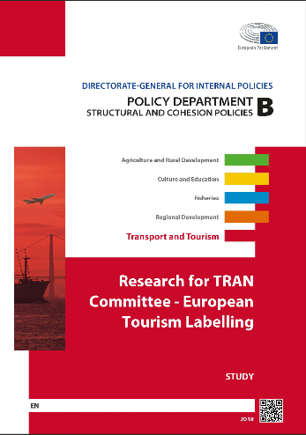
TRANSPARENCY: WHAT IS GOIN ON?
Sustainable Tourism Certification …
e.g.
1995: Yellow Book of Ecolabels (BMU)
2001: VIST (UNWTO)
2007: Environmental initiatives in Europe (EU, DBU)
2018: Tourism Ecolabelling (EP TRAN)
… is continuously growing!

Slide 6
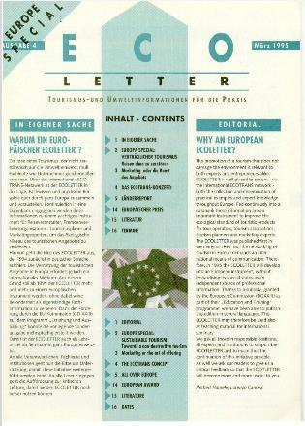
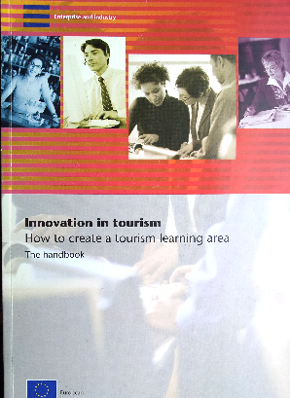

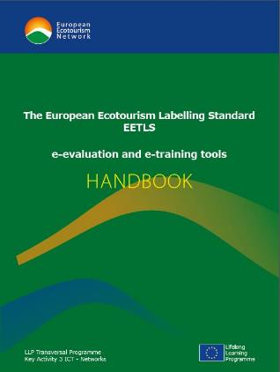
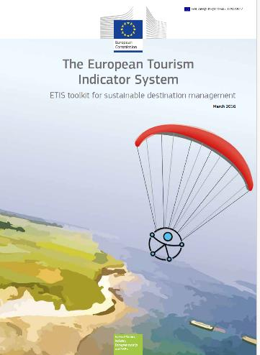

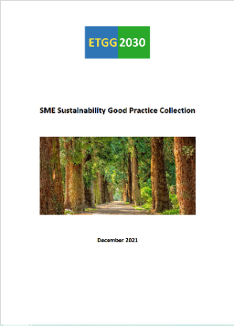
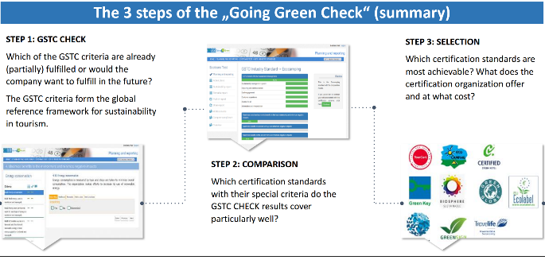
TRANSFER: WHAT CAN BE USED?
Dissemination & Exchange …
e.g.
1994: Ecoletter (DBU)
2006: Tourism Learning Area (EC)
2007: Destinet.eu portal
(EEA, Ecotrans, UNEP, UNWTO)
2014: EETLS tools (EU)
2016: ETIS (EU)
2016: Guide for German DMOs (DTV)
2021: ETGG2030 Best Practices (EU)
2024: Going Green Check for accommodations (DE)
… from print to online!

Slide 7
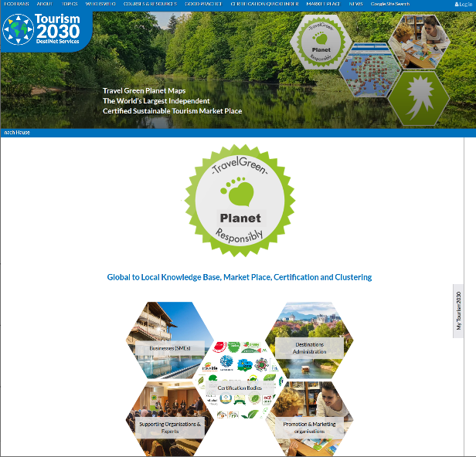
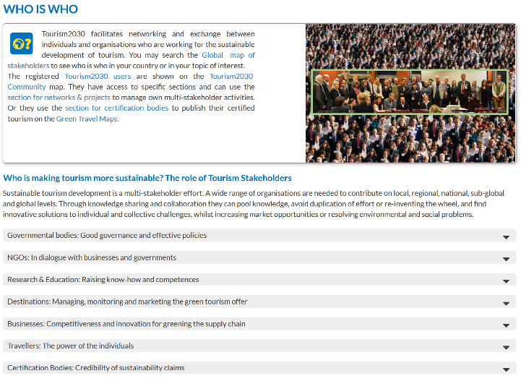
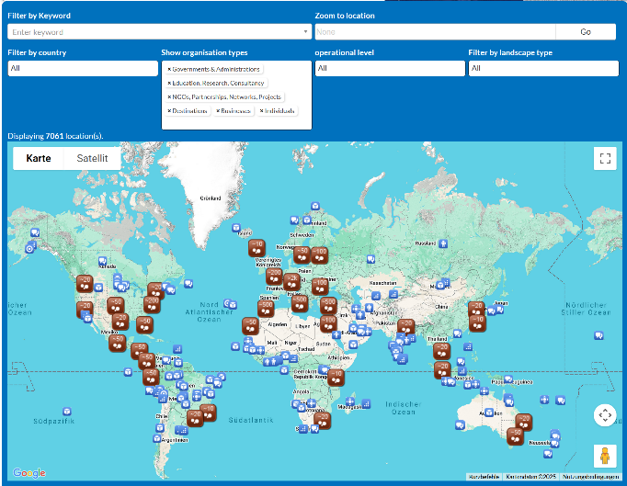
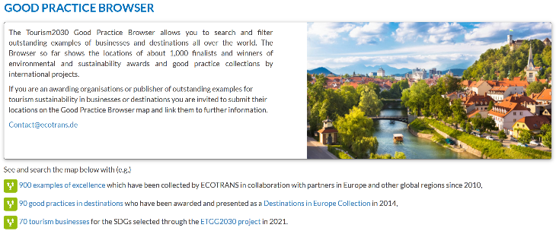
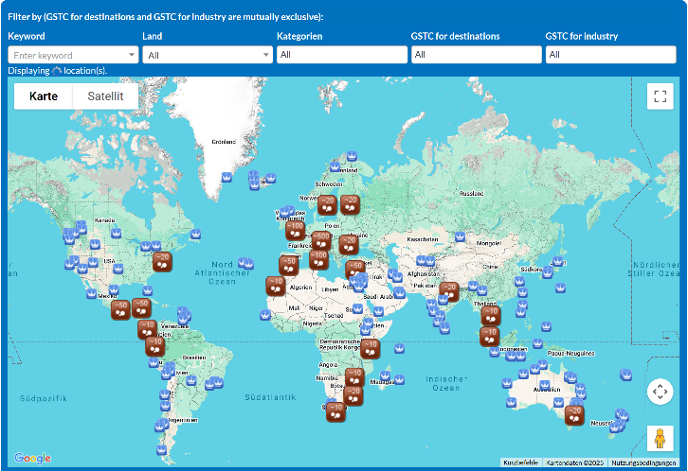
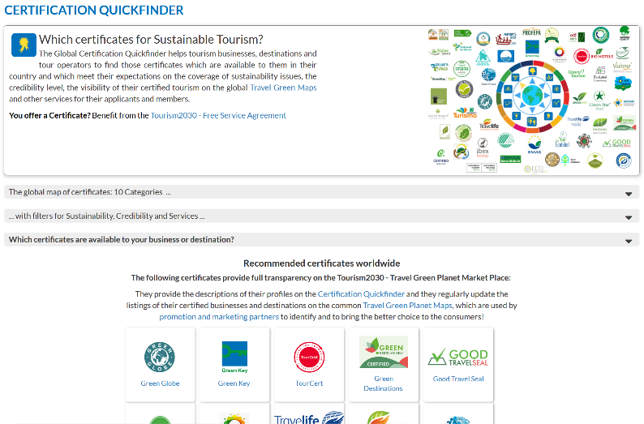
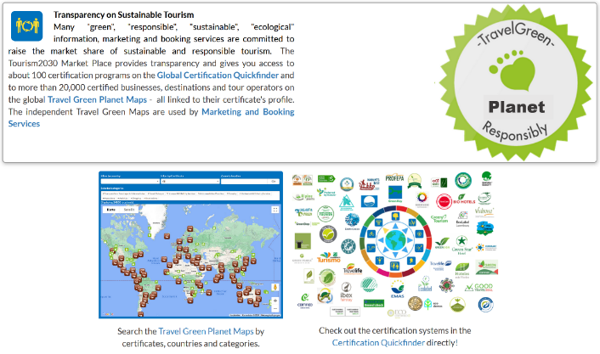

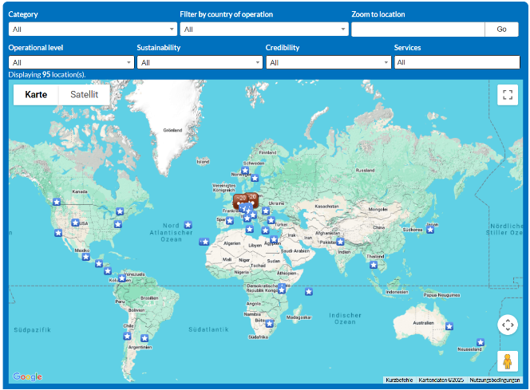
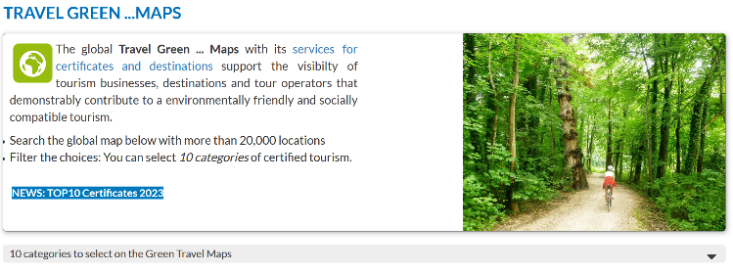
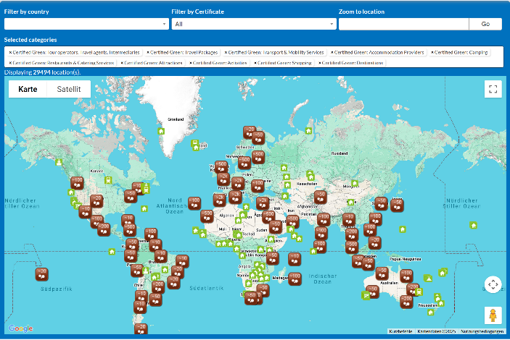
TRANSFER: WHAT CAN BE USED?
Tourism2030.eu portal …
2010: EEA handing over
Destinet.eu to Ecotrans
2016: Relaunch & partnership for the SDGs 2030
2025: independent portal
  multi-stakeholder
  multi-thematic
  multi-territorial
for supporting knowledge sharing & networking
… with content & maps for all

Slide 8
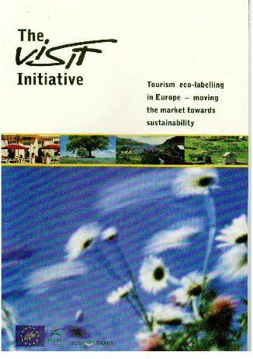
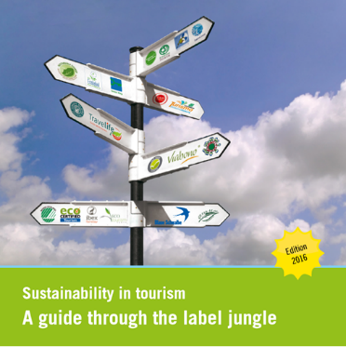
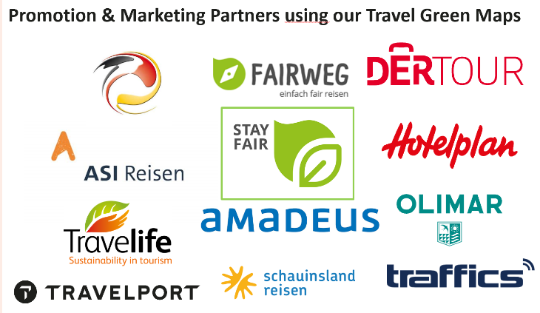
ECONOMY: HOW TO ACCESS THE MARKET?
Sustainable Tourism Marketing …
e.g.
2004: The VISIT Initiative (EU)
2016: Guide through the label jungle (Ecotrans et.al.)
2025: Travel Green Maps used by market players for awareness raising, promotion and marketing
… with certified green claims!

Slide 9
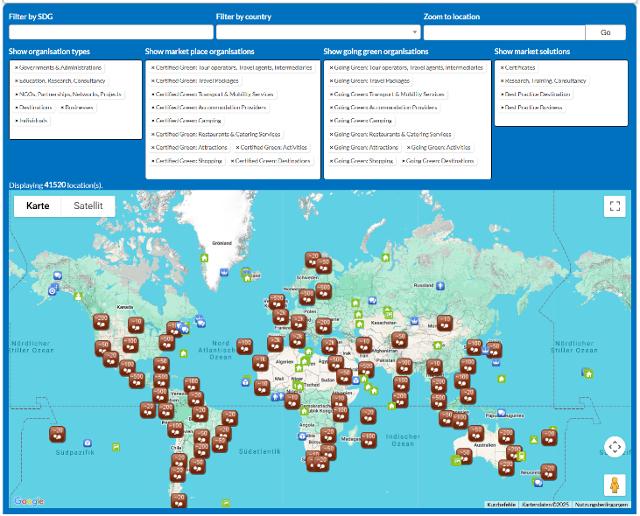
for destinations: Going Green maps
2022: The GOING GREEN Map for destinations is connecting …
stakeholders, supporters and experts with
available certificates,
best practices sustainability initiatives and
their participants going green,
and certified green businesses and services
… is a GOOD GOVERNANCE tool
for monitoring green transition
Planning & marketing the green offer

Slide 10
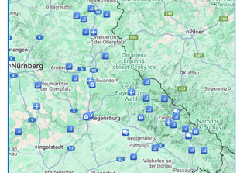






example: destination „East Bavaria“
Map of “blue” public & private stakeholders to bring them together and make a sustainable tourism CLUSTER
1|
Cluster Organization Map
DMOs & Administration
Thematic networks with businesses
Academic organisations & experts
Environmental & cultural NGOs
80

Slide 11
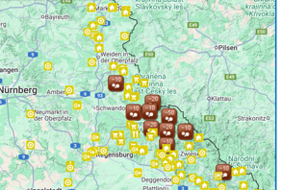










example: destination „East Bavaria“
Map of “yellow” businesses with GREEN CLAIMS supporting EU Taxonomy objectives
2|
Going Green Business Map
Hotels, Camping, other accommodation
Restaurants & Catering Services
Transport & Mobility
Attractions & activities providers
Tour operators & travel agencies
350

Slide 12
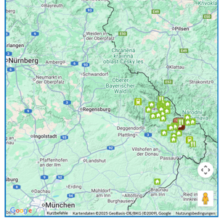
example: destination „East Bavaria“
Travel Green Map
Map of “green” certified businesses as base for TRANSILIENCE indicators and MARKETING
3|
Hotels, Camping, other accommodation
Restaurants & Catering Services
Transport & Mobility Services
Attractions & activities providers
Tour operators & travel agencies
70

Slide 13
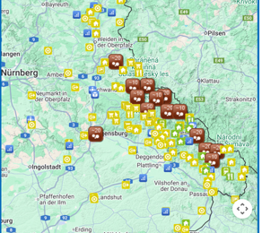



example: destination „East Bavaria“
Going Green Sustainability Map
4|
All on one map: GOOD GOVERNANCE TOOL for DMOs and policy makers
Cluster organisations
Businesses going green
Businesses certified green
500

Slide 14
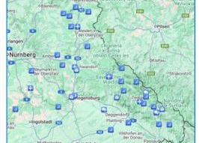

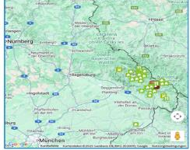
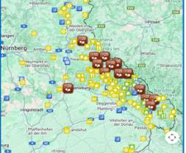

example: destination „East Bavaria“
Cluster Organization Map →
Going Green Business Map →
Travel Green Map →
Going Green Sustainability Map
80
350
70
500
Next step 2026:
100 SMEs will do the Going Green Check and (potentially) go for Certification

Slide 15

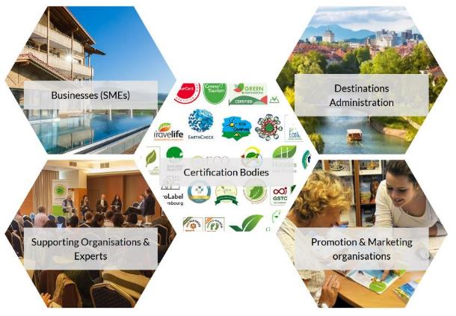



coming 2026: The Going green ecosystem

Slide 16

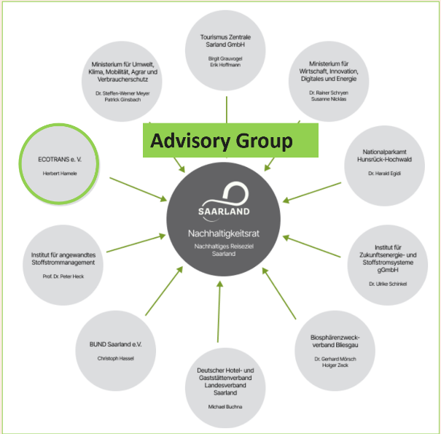
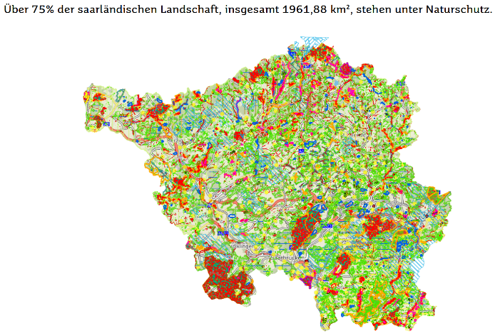
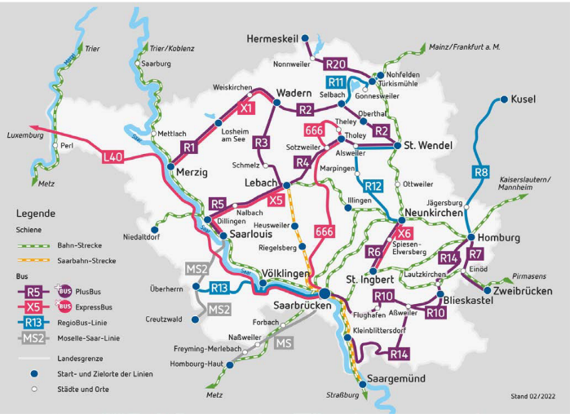
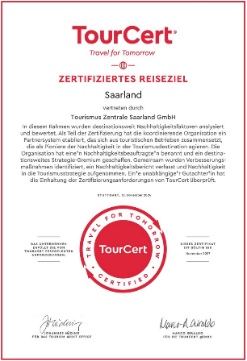
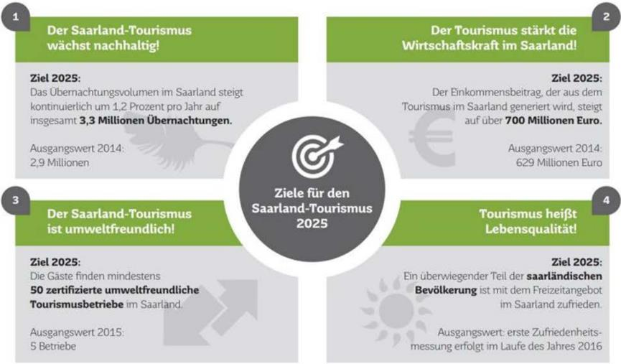
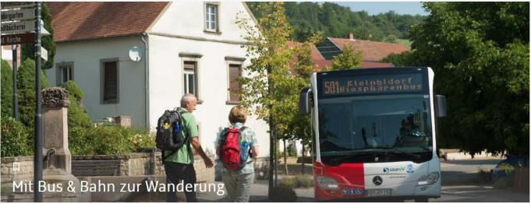
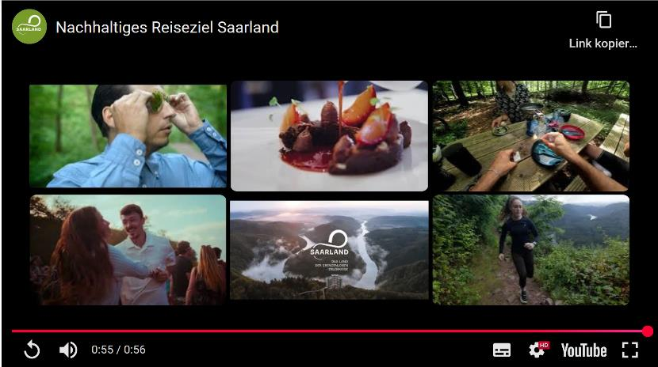
Destination „Saarland“: gooD governance
Saarland Tourism
is growing sustainably!
Tourism strengthens Saarland economy!
Promotion Video for visitors & guests:
Catchy words, Story telling, Social Media, …
Tourism is
environmentally friendly!
Tourism means
Quality of Life!

Slide 17




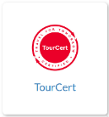

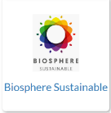










Not a dream: destinations in europe …
are drivers for the SDGs 2030
are transforming European Tourism
are promoted by their countries (NTOs)
are drivers for sustainable tourism
connect their plans and strategies to the global SDGs
Implement the European policies
use supporting systems, e.g.
Going Green
Go for certification
World
Europe
Country
Destination
Businesses

