Slide 1
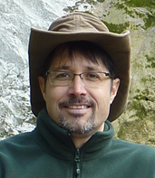
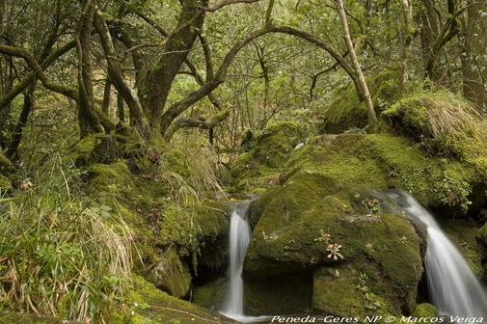
Sustainable Tourism Networking in Europe
PANParks
Zoltan Kun
Pan Parks Foundation Executive director
zkun@panparks.org

Slide 2
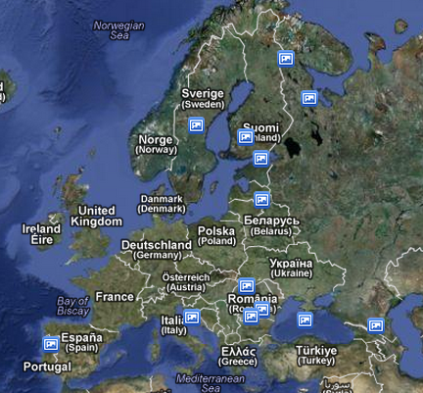
Sustainable Tourism Networking in Europe
PANParks / Tourism Model
www.panparks.org
Main Achievements:
35 000 EUR / 2011
47 000 EUR / 2012 available for wilderness protection
Members:
43 local business partners
12 incoming operators
6 international tour operators
9 destinations
61 businesses

Slide 3
Sustainable Tourism Networking in Europe
PANParks / Tourism Model
www.panparks.org
Applied tools :
Certification of destination (protected areas with wilderness)
Challenges:
Promoting the wilderness areas as destination in the increasingly competitive market in Europe
Getting more international tour operators as partners

