Slide 1
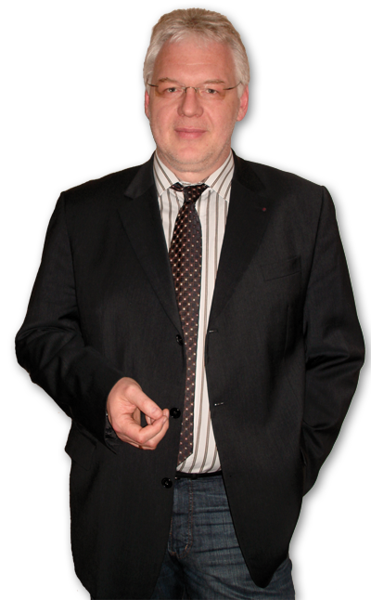
Sustainable Tourism Networking in Europe
Green Destination Viewer
Volker Schmidt
TravelMotion GmbH
www.travelmotion.de / www.xtraviewer.com
vs@travelmotion.de

Slide 2
Sustainable Tourism Networking in Europe
Green Destination Viewer
www.travelmotion.de
Members:
Destination involvement: Pilot destination = Mostviertel (Austria). Other interested destinations are in process
Businesses involvement: All toursim actors can take part, on condition that they have a sustainable product and/or services
Objectives:
Basic: Green Destination Viewer is ready to run
Pilot developments are closed and we now start canvassing

Slide 3
Sustainable Tourism Networking in Europe
Green Destination Viewer
www.travelmotion.de
Applied tools :
GDV partners have to fulfill certain sustainable criteria
DestiNet: Cerificates and Awards, Destinations and Businesses on the DestiNet Market Place Atlas
Challenges:
Developping and establish the Xtraviewer.com online magazine for customers
Xtraviewer online training area
Realizing online marketing / sales campaigns
to motivate travel agents / tour operators and
even customers as well Custom-specific
accommodations and progression

