Slide 1
Sustainable Tourism Networking in Europe
VISTAS
Valere Tjolle
TravelMole
www.travelmole.com
valere@travelmole.com

Slide 2
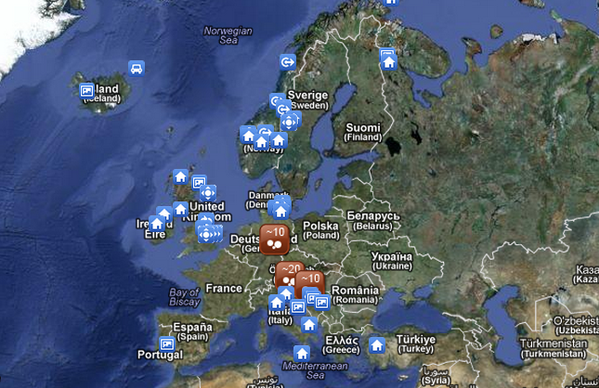
Sustainable Tourism Networking in Europe
VISTAS
VISION FOR INNOVATION IN SUSTAINABLE TOURISM AWARD
www.travelmole.com
Members:
Destinations involvement: EDEN Desinations of Excellence,
Quality Coast, Alpine Pearls to be broadened
Businesses involvement in receiving certificates and awards
and as nominating bodies
Objectives:
Recognition, showcase and promotion of excellence in innovation in Sustainable
Tourism

Slide 3
Sustainable Tourism Networking in Europe
VISTAS
VISION FOR INNOVATION IN SUSTAINABLE TOURISM AWARD
www.travelmole.com
Applied tools :
DestiNet: Cerificates and Awards, Atlas of Excellence
Vast promotion and showcasing of sustainable tourism globally through TravelMole.com, Vision on Sustainable Tourism and TotemTourism.com/TourismVision.com
Challenges:
Financing
Networking
Diversity of stakeholders
Making the very successful European into a global
award

