Slide 1
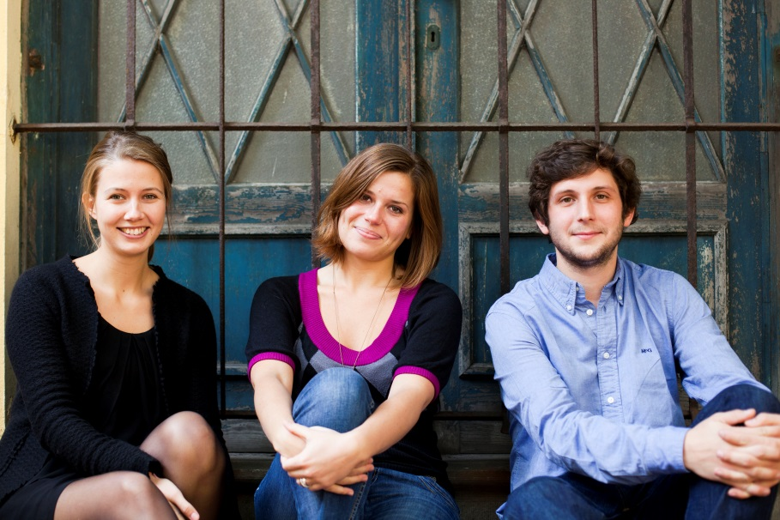
Sustainable Tourism Networking in Europe
GreenHopping
Roxane Kaempf
GreenHopping
www.greenhopping.eu
roxane.kaempf@greenhopping.eu

Slide 2
Sustainable Tourism Networking in Europe
www.greenhopping.eu
Objectives:
Increasing visibility of European green businesses and destinations
Raising consumer’s awareness on the existing certified offers and on sustainable tourism practices more generally
Making travellers discover and dream about unique European green destinations
Website Beta launch within the end of April

Slide 3
Sustainable Tourism Networking in Europe
www.greenhopping.eu
Applied tools :
Trip planning tool
Marketing tool: SEO & SEA, Social media, Public relations, Webvideo content
Latest technologies tools enabling accurate statistics procurement for businesses and destinations
Challenges:
Finding partnerships and development opportunities
Website Beta launch within the end of April
Increased knowledge in Sustainable Tourism
Covering our investments and costs
Communicating and getting traffic at a European level

