Slide 1
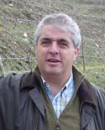
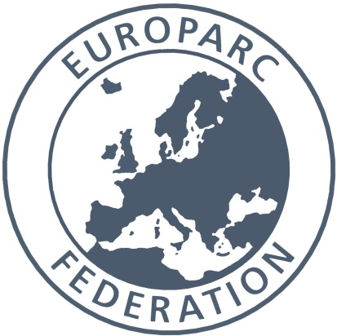
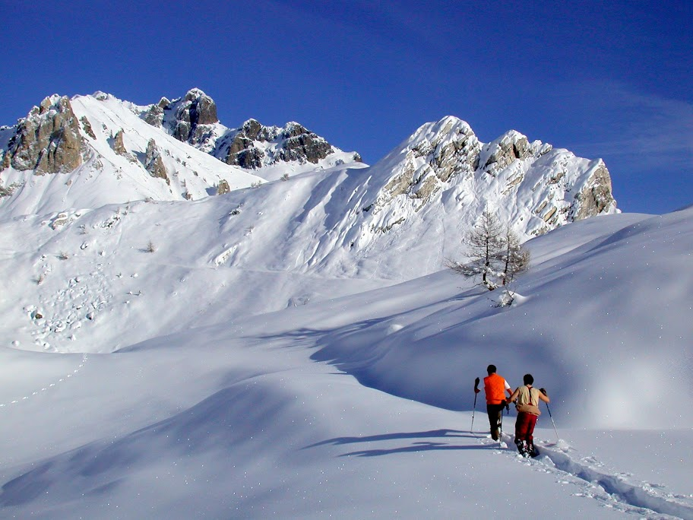
Sustainable Tourism Networking in Europe
European Charter Parks
Paulo Castro
EUROPARC
www.europarc.org
p.castro@europarc.org

Slide 2
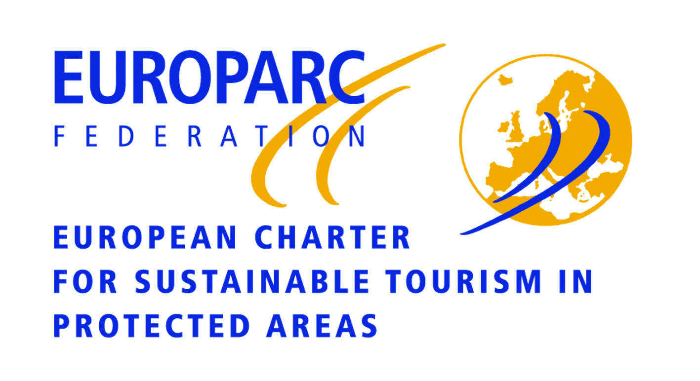
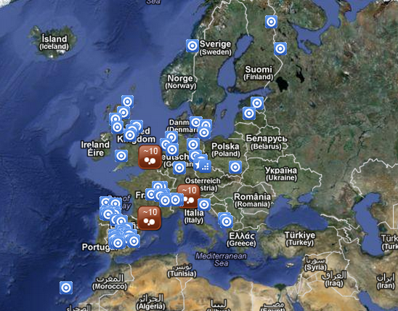
Sustainable Tourism Networking in Europe
European Charter Parks
www.european-charter.org
Main Achievements:
Successful implementation of the 10 principles of the Charter for over ten years
Involvement of over 3200 private and public businesses and organizations in 107 Sustainable Tourism Forums
Recognition of the Charter Partner Status to more than 400 tourism business actively involved in Charter protected areas in Sp, Fr and UK
Charter Network and joint
international project activities
External verifiers and an independent
Charter Evaluation Committee
Members:
107 protected areas from 13 countries
407 local tourism businesses in 23 Charter Areas

Slide 3
Sustainable Tourism Networking in Europe
European Charter Parks
www.european-charter.org
Applied tools :
Protected Areas apply to become Charter Parks with an application dossier, a Diagnostic of the territory, a SWOT analysis, a Sustainable Tourism Strategy and Objectives and an 5 year term Action Plan; certification is done after a visit of a verifier that produces a verifier report submitted to an Evaluation Committee
Participation in comparative studies (with CBD Guidelines, etc.), Monitoring is assumed in each Action Plan and global indicators are been produced
Communication, newsletter, official site, networking and presence in events, fairs, etc.
Challenges:
Developing of an integrate monitoring scheme
Further developing of the Charter Partner phase
Seeking harmonization of criteria and procedures with other awarding systems
Developing the phase III of the European Charter involving tour operators
Promoting visibility next to the public

