Slide 1
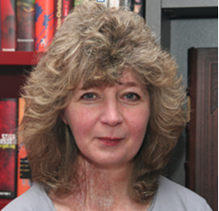
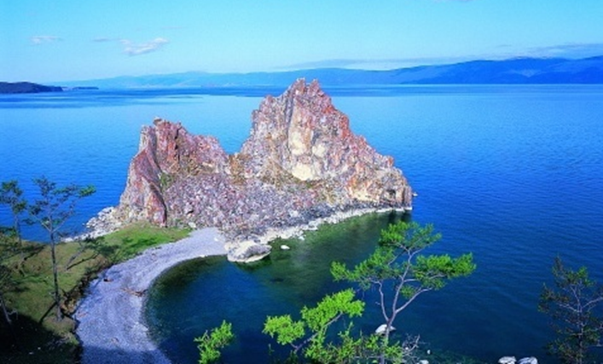
Sustainable Tourism Networking in Europe
Living
Lakes
Marion Hammerl
Lake Constance Foundation
and Global Nature Fund marion.hammerl@bodensee-stiftung.org

Slide 2
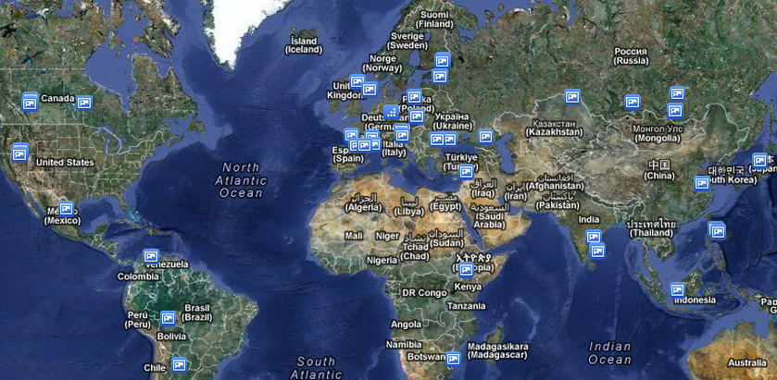
Sustainable Tourism Networking in Europe
International Living Lakes Network
for the protection of lakes and wetlands
www.globalnature.org
Achievements:
Measurable contribution to restoration and protection of lakes
Continuous extension of the network, currently 102 lakes represented
Cooperation agreements with international institutions
Continuous improvement of exchange of information
Capacity building for NGOs (trainings, publications, conferences)
More than 100 joint projects
Concrete achievements Living Lakes Goals Brochure:
http://www.globalnature.org/Publikationen
Members:
Ca 120 Organizations
Collaboration with businesses
and some companies sponsor the
Living Lakes Network.

Slide 3
Sustainable Tourism Networking in Europe
International Living Lakes Network
for the protection of lakes and wetlands
www.globalnature.org
Applied Tools:
Knowledge Pool on the website with studies, links etc. for all topics relevant for lake protection
Training is realized within concrete projects and via thematic training workshops. Webinare are also an upcoming tool which we are using. Every 2 – 3 years we organize an international Living Lakes Conference. The next will be in October 2013 at Lake Constance
Challenges:
Finding the financial resources for the coordination of the network is becoming more and more difficult. But without sound coordination it is not possible to assure the quality of networking.
Organizing exchange of information and experience in a structured and efficient way

