Slide 1
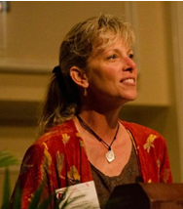
Sustainable Tourism Networking in Europe
Global Sustainable Tourism Council
Kelly Bricker
GSTC Associate Professor, University of Utah kelly.bricker@health.utah.edu

Slide 2
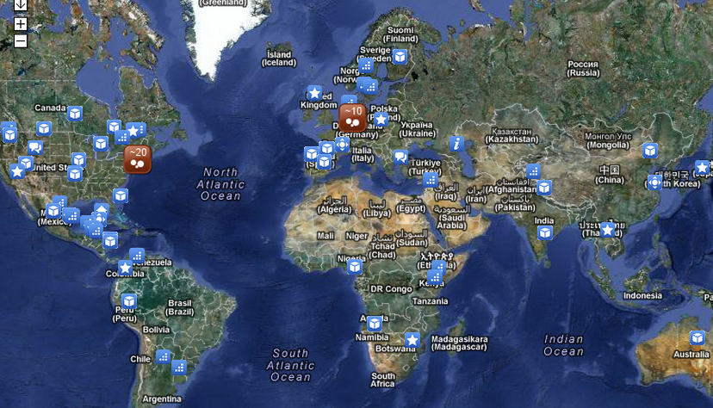
Sustainable Tourism Networking in Europe
GSTC
www.gstcouncil.org
Main Achievements:
Criteria: tour operators, accommodation, destinations (in progress)
Developed an introduction to the GSTC training course
Education and training working group: developing partnerships
Members:
More than 100 members

Slide 3
Sustainable Tourism Networking in Europe
GSTC
www.gstcouncil.org
Applied Tools:
GSTC Module-introduction and advanced level programs for tourism professionals or educators
Developing train the trainer auditor program
Partnerships with universities
Challenges:
Financial resources to continue to develop and update materials
Network to understand what has already been produced, not reinventing the wheel
Diverse needs present, professional development and development for new professions (students etc.)
Widespread support from the tourism industry

