Slide 1
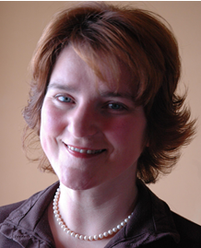
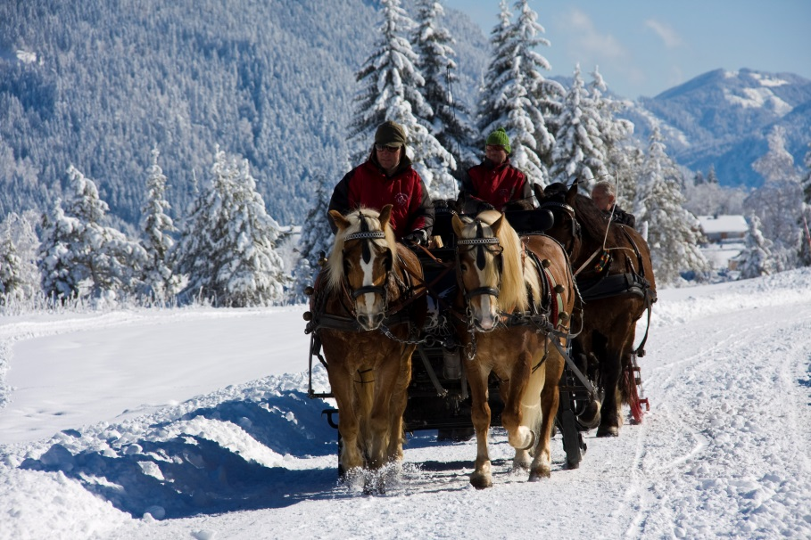
Sustainable Tourism Networking in Europe
Alpine Pearls
Karmen Mentil
ÖAR Regionalberatung GmbH
mentil@oear.at

Slide 2
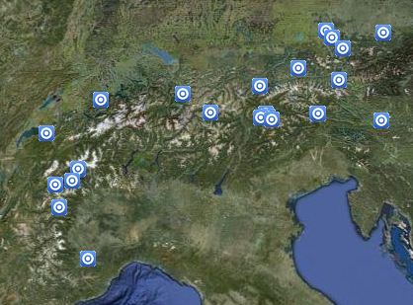
Sustainable Tourism Networking in Europe
Alpine Pearls
www.alpine-pearls.com
Main Achievements:
Alpine Pearls promotes and communicates sustainable tourism with environmentally-friendly mobility. The association’s 28 members profit from the professional communication activities and shared experiences
Alpine Pearls has successfully formed a strong European tourism brand for eco-holidays.
Members:
28 tourism municipalities
Direct contact or involvement with the businesses, cooperation activities with partners like KTM (for E-Bikes), OEBB and DB (for train services), and other industry partners.

Slide 3
Sustainable Tourism Networking in Europe
Alpine Pearls
www.alpine-pearls.com
Applied tools :
Training: workshops, study visits, manuals, etc
Certification and monitoring: criteria control via external control body
Marketing: image campaigns, media work, PR, internet incl. campaigns and social media
Challenges:
Improving quality standards and tourism offer of soft mobility in our pearls
Building-up of intense cooperation with railway and bus companies
Multiplying the idea by tourism product development with the hotels and enterprises in the pearls

