Slide 1
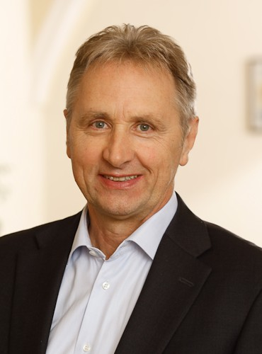
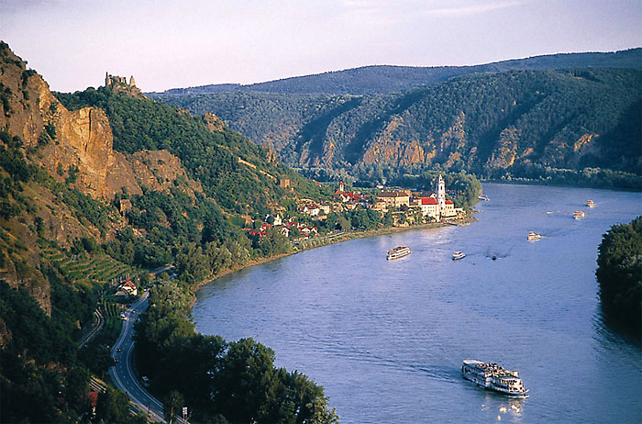
Sustainable Tourism Networking in Europe
TransDanube
Karl Reiner
ÖAR Regional Consulting
Tourism department
reiner@oear.at

Slide 2
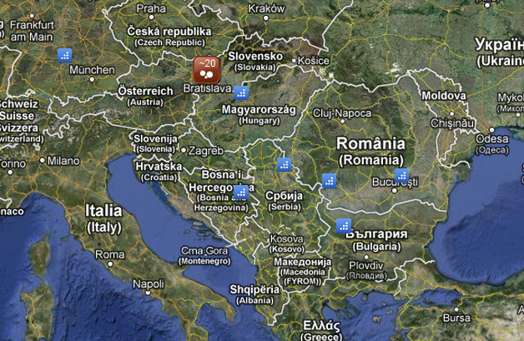
Sustainable Tourism Networking in Europe
Soft-Mobility & Tourism in the Danube Area
Lead Partner Environmental Agency
www.transdanube.eu
Main Achievements:
Environmentally friendly modes of transport in order to improve the accessibility and facilitate the concept of sustainable tourism in the whole Danube region.
Intersectorial approach
combining the transport
and the tourism sector
Members:
13 Project Partners,
more than 25 Observers

Slide 3
Sustainable Tourism Networking in Europe
Soft-Mobility & Tourism in the Danube Area
Lead Partner Environmental Agency
www.transdanube.eu
Applied Tools:
Guideline State of the Art
Good Practice Collection
Challenges:
Different experience/status
Finding the right partners for implementation
Financial means

