Slide 1
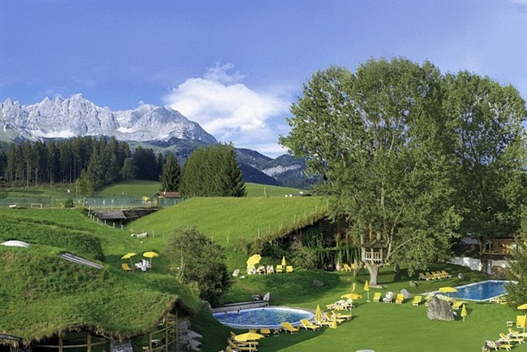
Sustainable Tourism Networking in Europe
EARTH
European Alliance of Responsible Tourism and Hospitality
José Maria de Juan
Vice-president of EARTH
for the Communication and Relations
with Iberoamerican Entities
www.earth-net.eu
josemadejuan@yahoo.es

Slide 2
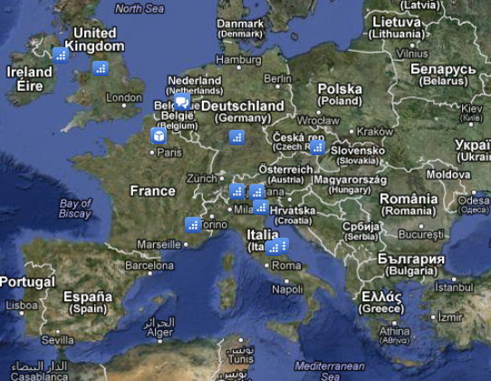
Sustainable Tourism Networking in Europe
EARTH - European Alliance of Responsible Tourism and Hospitality
www. earth-net.eu
Main Achievements:
EARTH promotes all the values of responsible tourism at the local, national and the European level. It has been created by professionals of sustainable and responsible tourism, in order to create a coherent action and to promote the principles of sustainability, fairness and solidarity for tourism at the European level
Members:
15 private organizations present in 7 European countries. The members include training organizations, tour operators, consultancy firms, networks, bodies for the protection of the heritage and the environment, cooperatives, centres of ecology and development

Slide 3
Sustainable Tourism Networking in Europe
EARTH - European Alliance of Responsible Tourism and Hospitality
www. earth-net.eu
Applied tools :
There is a wide variety of tools, activities and measures, as most of EARTH members are involved in development projects, tourism operations and certifications all over the world. Among them we can quote as certifications involved Tourcert and Travelife
Challenges:
Becoming a stronger network by including new members and doing more concrete actions in the ground
Ensuring a better representation of the principles of responsible principles in the European Tourism policies
Participating to European projects and networking activities to strengthen and disseminate the concept of responsible tourism among private and public tourism sectors

