Slide 1
Sustainable Tourism Networking in Europe
Introduction
Herbert Hamele
ECOTRANS
Founder and president herbert.hamele@ecotrans.de

Slide 2
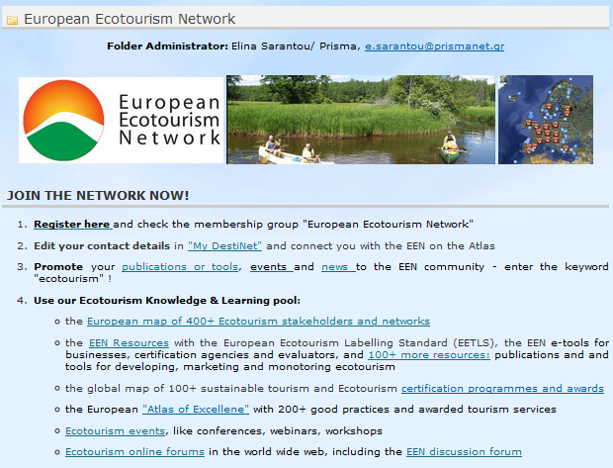
Sustainable Tourism Networking in Europe
Members:
PRISMA-GR
ECOTRANS-DE
ECEAT-NL
AER-RO
EMÜ-EE
NAPIER-GB
Pan Parks-NL
CTS-IT
IMA-IT
ECOTONO-ES
Silvacultura-FI
ESTECAS-EE
Main Achievements:
European Ecotourism Labeling Standard – EETLS – structured according to the GSTC, completed with indicators and good practice examples, “GSTC recognized standard”
E-tools development: for self assessment by tourism businesses (e.g. hotel or tour operator) and evaluation, currently: pilot phase
Setting up a European Ecotourism Network – EEN - seeking collaboration with other initiatives

Slide 3
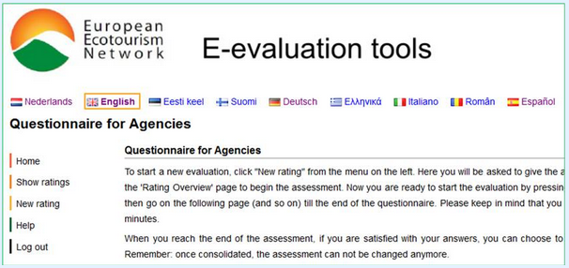
Sustainable Tourism Networking in Europe
Destinations involvement:
Few protected areas as “destinations” (e.g. Pan Parks, European Charter parks), but not main target group
Businesses involvement:
About 30 businesses in the pilot phase: hotels and camping sites with relation to nature tourism/experience, local/regional tour operators
Applied tools:
EETLS & good practices
e-tools for businesses & agencies
Challenges:
Positioning within the context of existing certification programmes, tools, networks, national differences
Sustaining the project results: finance, integration with other initiatives, further development

