Slide 1
Sustainable Tourism Networking in Europe
The International Ecotourism Society
Ferdinand Weps
The International Ecotourism Society
Director of Membership and Operations

Slide 2
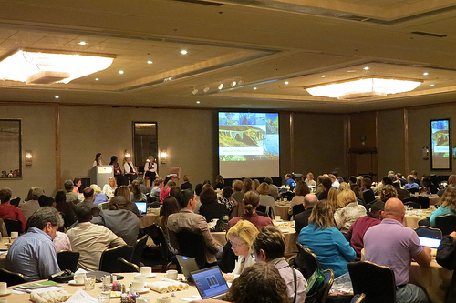
Sustainable Tourism Networking in Europe
The International Ecotourism Society
www.ecotourism.org
Members:
1200 – Organization and Professionals from different fields: Tour Operators, Accommodations, NGOs, Governments and CVBs, Service Supplier, from over 135 countries

Slide 3
Sustainable Tourism Networking in Europe
The International Ecotourism Society
www.ecotourism.org
Applied Tools:
Several tools in place for the industry. From training and education to a professional network for knowledge exchange
Main Achievements:
Founded in 1990, TIES has been on the forefront of the development of ecotourism, providing guidelines and standards, training, technical assistance and educational resources

