Slide 1
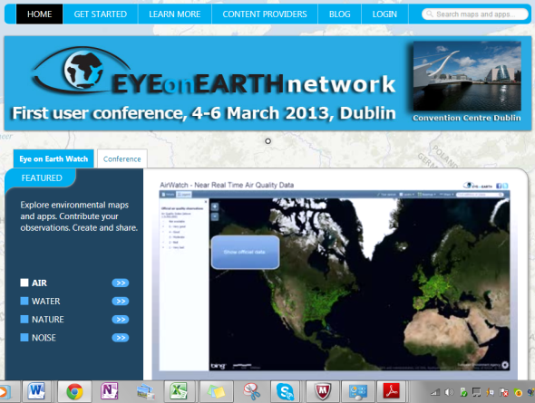
Eye on Earth Network
Gordon Sillence
Ecotrans-DestiNet
March 7th Berlin ITB

Slide 3
About Eye on Earth
EEA leading the process
Aimed at citizen participation – crowd sourcing and citizen science
Establishing user communities reporting on environmental issues
Focused on environmental data
Supported by UNEP and member states
Supports EEA State of the Environment reporting

Slide 4
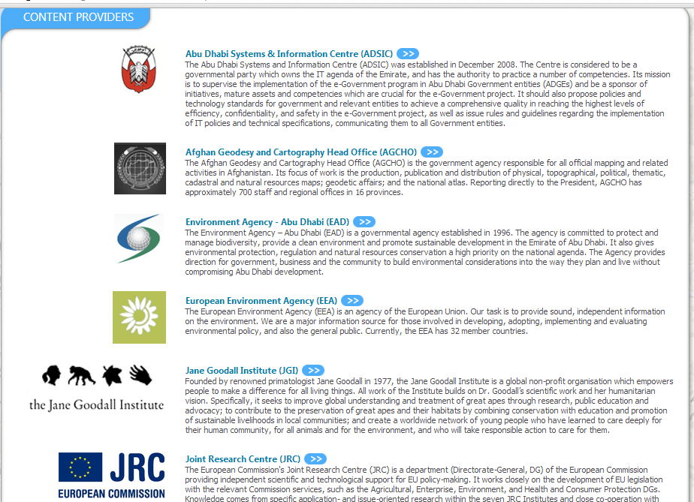
Examples of User Communities

Slide 5
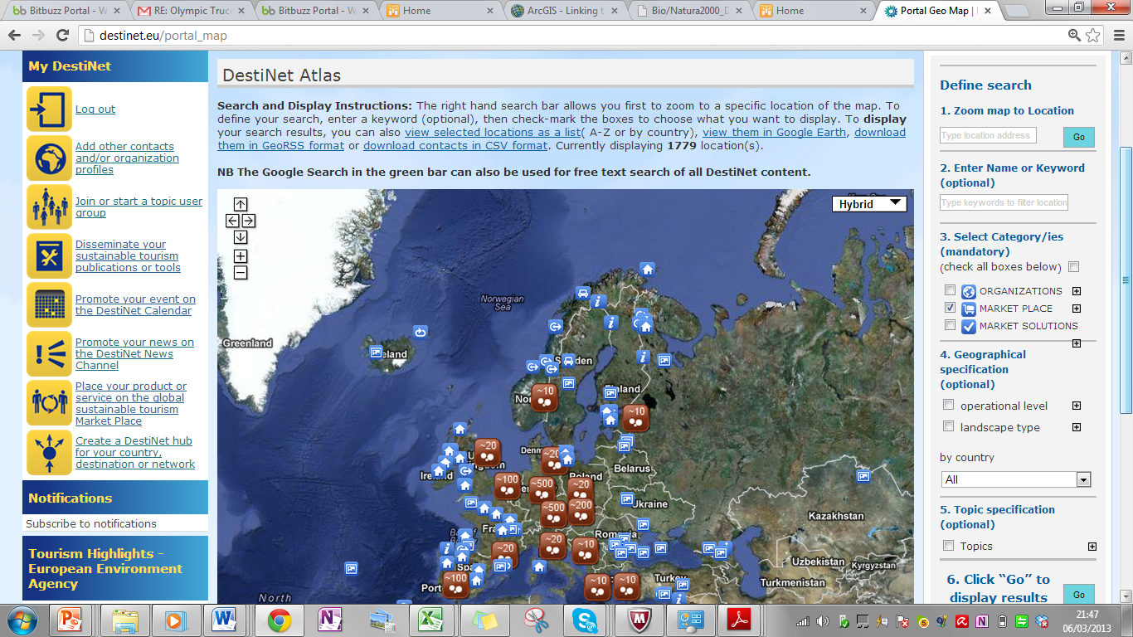
Example of Using the Tools

Slide 6
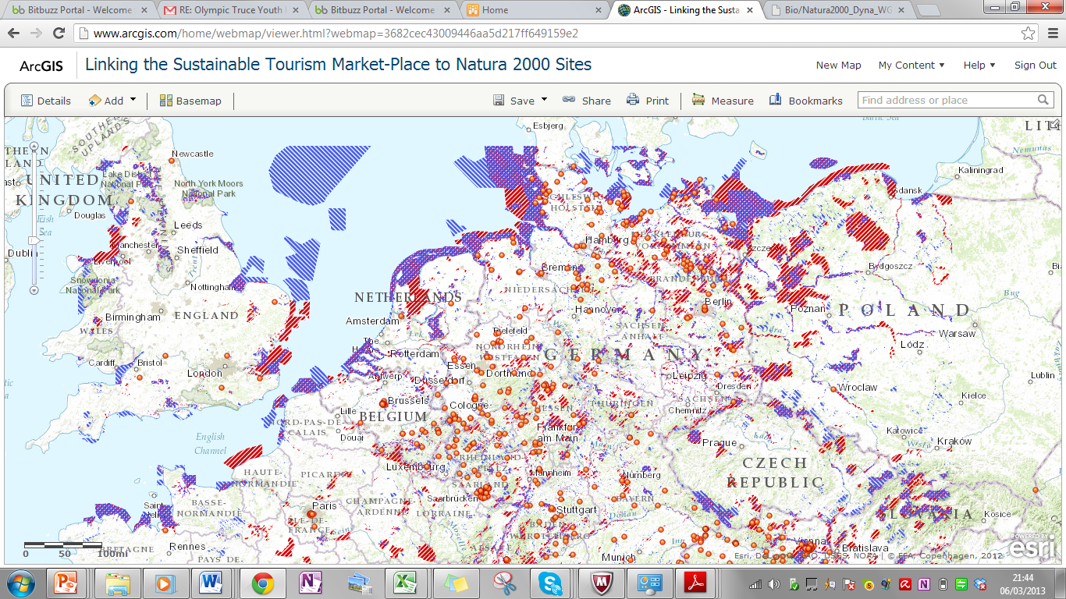
Map of quality assessed tourism businesses with Natura 2000 Overlay

Slide 7
Is a GIS technology network
Based on Open Standards
Has implications for environmental monitoring at the destination level
You can construct you own layers and use others
You can build you own applications for monitoring purposes
Requires training for use

