Slide 1
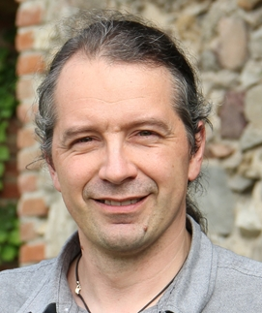
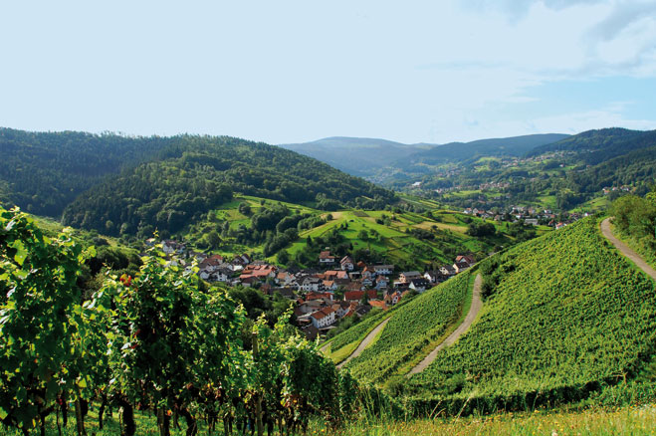
Sustainable Tourism Networking in Europe
Landscape of the Year
Christian Baumgartner
Naturfreunde International (NFI)
www.nf-int.org
christian.baumgartner@nf-int.org

Slide 2
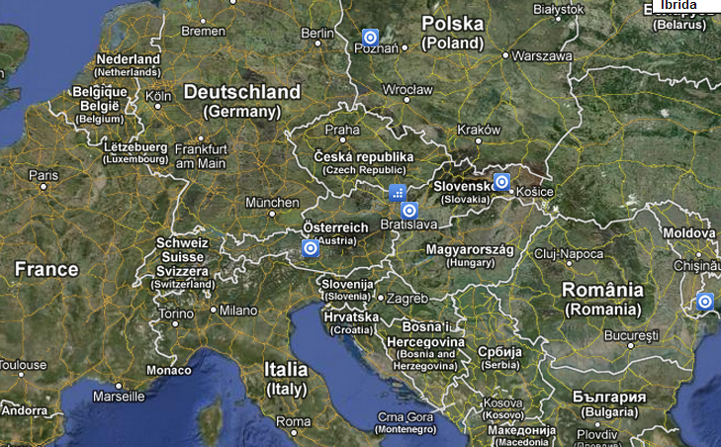
Sustainable Tourism Networking in Europe
Landscape of the Year
www.landscapeoftheyear.net
Main Achievements:
Initiatives for SD and ST in all Landscapes of the Year: Regional development Organisations, training courses, regional tourism road maps, quality criteria, etc.
UNWTO Ulysses award for innovative tourism projects – 2012
Members:
13 cross-border landscapes all over Europe: DE, AT, CH, CZ, PL, FR, NL, BE, HU, SK, RO, UA;
Multi-stakeholder participation approach

Slide 3
Sustainable Tourism Networking in Europe
Landscape of the Year
www.landscapeoftheyear.net
Applied tools :
Sustainability assessment, multi-stakeholder participation, need-based-training, train the trainers
Development of local training institutions, regional development associations, etc
Challenges:
Finding interesting and interested cross-border regions with existing naturefriend structures.

