Slide 1
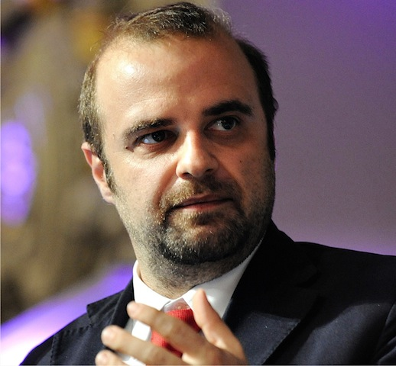
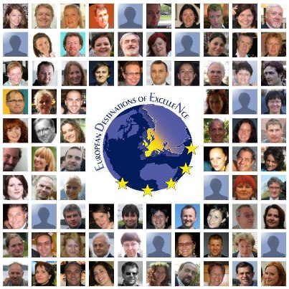
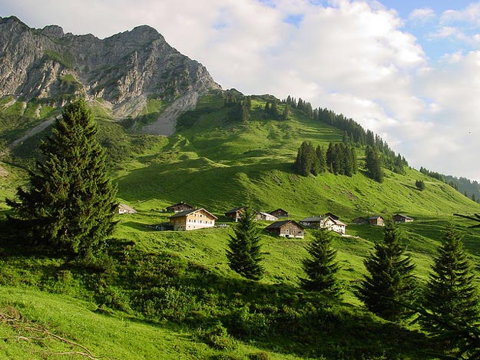
Sustainable Tourism Networking in Europe
EDEN
Antonio Pezzano
EDEN Network Facilitator
edenet.facilitator@gmail.com

Slide 2
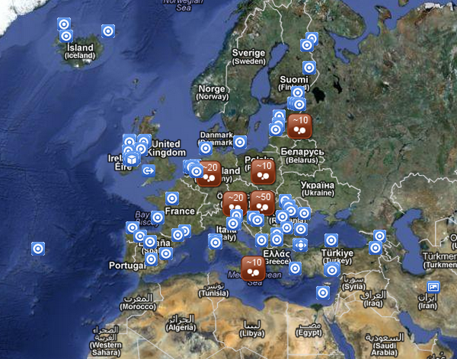
Sustainable Tourism Networking in Europe
EDEN network association AISBL
www.edenpost.org
Outcome of the EDEN Project ec.europa.eu/eden
Main Achievements:
The largest network of
sustainable destinations
in the world
Members:
80 Destinations

Slide 3
Sustainable Tourism Networking in Europe
EDEN network association AISBL
www.edenpost.org
Applied tools :
Social Media marketing
Challenges:
Creating National network inside the European level
Trusting the stories of other destinations
Evaluating the level of quality of the different EDEN destinations in the long run, also regarding the fact that each EDEN winner has been chosen at a national level
with different rules and according a precise theme

