Slide 1
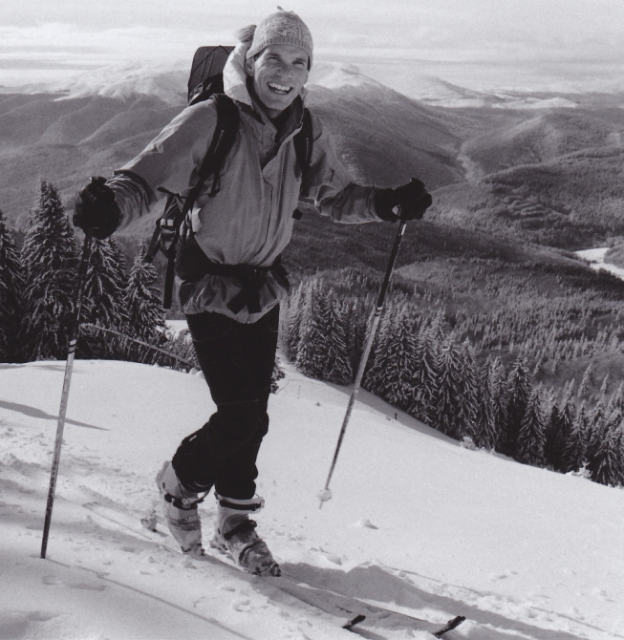
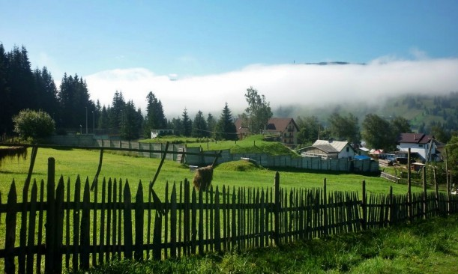
Sustainable Tourism Networking in Europe
Ecotourism Destinations in Romania
Andrei Blumer
Association of Ecotourism in Romania
www.eco-romania.ro
andrei.blumer@eco-romania.ro

Slide 2
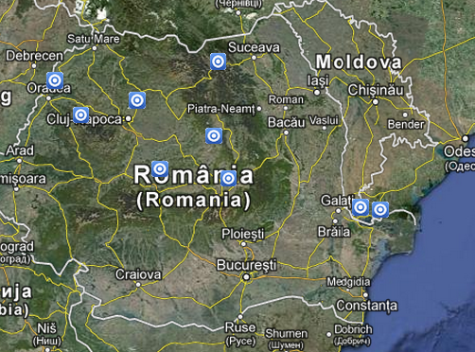
Sustainable Tourism Networking in Europe
Ecotourism Destinations in Romania
www.eco-romania.ro
Main Achievements:
Running Eco-Romania as an independent certification scheme that offers guidance for businesses
Members:
AER – 51 members, out of which 33
business, out of which 11 certified
with Eco-Romania
10 ecotourism destinations
in Romania
11 businesses certified with Eco-
Romania not direct members of AER

Slide 3
Sustainable Tourism Networking in Europe
Ecotourism Destinations in Romania
www.eco-romania.ro
Applied tools :
Training are project based (when available funding from projects)
Certification includes a self evaluation and an in-situ evaluation
done by an evaluator
Marketing – any certified businesses with Eco-Romania is
marketed through all our channels (website, brochures, travel
shows, etc.)
Monitoring – feedback from clients and direct discussions with businesses (re-evaluation every third year)
Challenges:
Lacking of strategic support from the ministry side
Funding for a national programme

