Slide 1
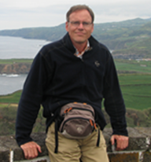
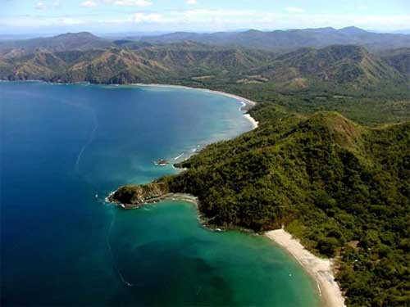
Sustainable Tourism Networking in Europe
QualityCoast
Albert Salman
Coastal & Marine Union (EUCC)
www.eucc.net
a.salman@eucc.net

Slide 2
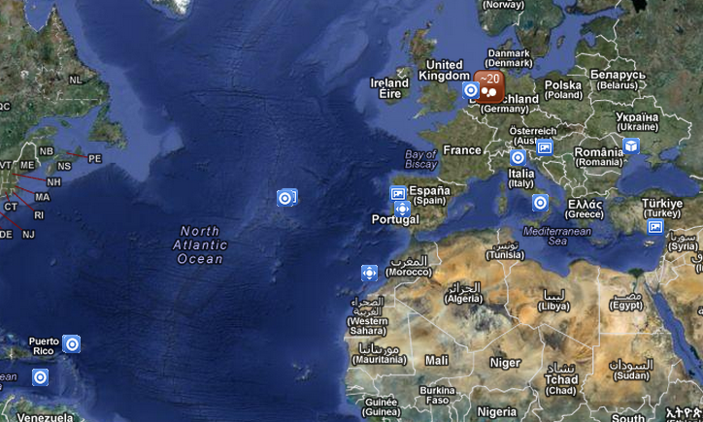
Sustainable Tourism Networking in Europe
QualityCoast
www.qualitycoast.info
Main Achievements:
The QualityCoast BasiQ scan is being applied to all coastal and island holiday destinations connected to TUI around the world
Members:
35 Destinations
Ca. 1000 experts involved
Cooperation with 5 tour
operators and cs. 15 businesses

Slide 3
Sustainable Tourism Networking in Europe
QualityCoast
www.qualitycoast.info
Applied Tools:
QualityCoast Award, combining BasiQ, ETIP and GSTC Destination Criteria
Destination certification (coastal & non-coastal) for GSTC Destination Criteria
BasiQ scan (also possible basis for naming and shaming, or SICKE indication)
QualityCoast Destinations Top 100
QualityCoast Regions Top 10
QualityCoast Flag (only for QC Award winners)
QualityCoast Communication programme
Challenges:
Making Awarded Destinations better known
Publishing BasiQ scans of > 1000 destinations and getting reliable and
manageable feedback from visitors

