Slide 1
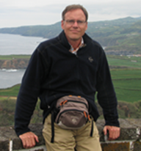
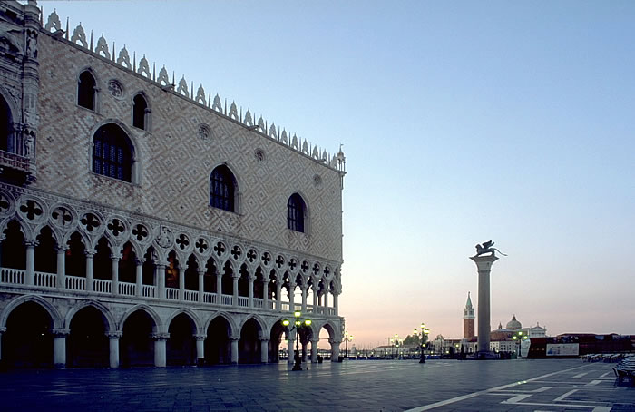
Sustainable Tourism Networking in Europe
NECSTouR
Albert Salman
Coastal & Marine Union (EUCC)
www.necstour.eu communication@necstour.eu

Slide 2
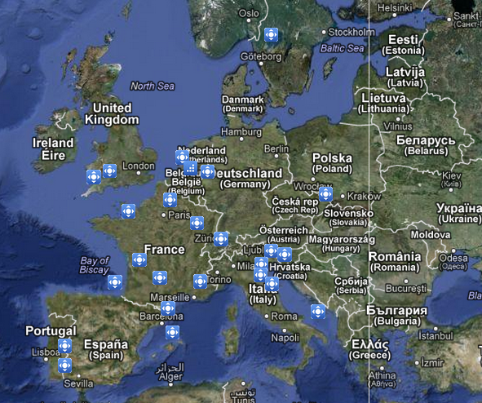
Sustainable Tourism Networking in Europe
NECSTouR
www.necstour.eu
Main Achievements - Some successful (ongoing) activities carried out in 2012 are:
Joint position for: European Charter for Sustainable and Responsible Tourism; Challenges and Opportunities for Maritime and Coastal Tourism in the EU; European Tourism Label for Quality Systems Initiative; COSME Programme.
Contribution to the studies Feasibility Study for Sustainable Tourism Indicators and Good Practices Collection for Growth & Jobs;
Active participation at the European Networks' tourism working group coordinated by the Eu Commission;
Cooperation with key sustainable tourism stakeholders:
EU Institutions, UNWTO, CoE, etc.
Projects Award and ongoing implementation:
T4EST Training for Sustainable Tourism*, ODYSSEA Itinéraire
Culturel des Ports & Cultures de la méditerranée and
NEZEH Nearly Zero Energy Hotels
Members:
27 full members (Regions)
30 associated members (Representatives of tourism enterprises, specialized tourism associations and academic sector)

Slide 3
Sustainable Tourism Networking in Europe
NECSTouR
www.necstour.eu
Applied tools :
NECSTouR three pillars are:
- Social Dialogue
- Competitiveness
- Monitoring and evaluation
Communication channels and tools including the Website and membership private area including the good practices data base, internal and external Newsletters, Twitter and video of promotion
ù
Participation to public events were the network is presented, either by the Permanent Secretariat or our members, who are our best ambassadors
Monitoring by the Permanent Secretariat through regular meetings with the European policy makers.
Challenges:
Reinforcing the role of Regions in the European tourism policy while coping with the transversal nature of the sector, which makes its coordination at European level a complex exercise

