Slide 1



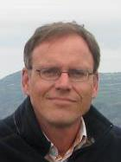

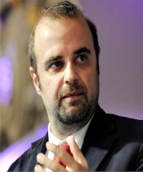



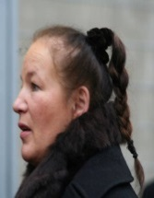
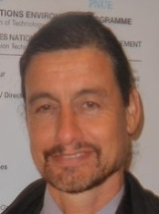




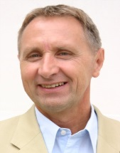




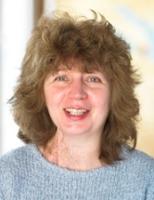








- Coastal Union
- QualityCoast
- Global Sustainable Tourism Review
- Global Partnership Hannover
- EDEN
- ACTA
Albert Salman
Anke Bidenkapp
Antonio Pezzano
- Friends in Germany
- Olympos2020
- IHK Courses
- DestiNet
- Janela Aberta
- ECOTRANS
- DestiNet
Erdmute Prokosh-Sander
Gordon Sillence
Herbert Hamele
- BASQUETOUR
- ÖAR
- Alpine Pearls
- ECOTRANS (Brussels)
Idurre Ostolaza
Karl Reiner
Lisa Davies
- Global Nature Fund
- Bodensee Stiftung
- Living Lakes
- Interpret Europe
- FUTOUR
- Green Globe
Marion Hammerl
Patrick Lehnes
Peter Zimmer
- The Tourism Company
-Travelmotion
- Service Plus Reisen
- Green Destination Viewer
- Travelmole/Visions
- VISTAS
Richard Denman
Valere Tjolle
Volker Schmidt

Slide 2

Content
1. Sustainable tourism in Europe: Challenges and solutions
Economy and society, nature and culture, climate change and resources, objectives and fields of actions
2. Sustainable management in tourism businesses
From the hotel industry through transport businesses to tour operators and MICE
3. Sustainable destination management
Destinations in the mountains, on the coast, in cities, on land and in protected areas (Ecotourism)
4. Instruments and practical examples
Inventory control, market research, innovation, certification, marketing, monitoring
5. Responsibility and quality
CSR, participation, qualification, service and customer orientation, communication
6. Cooperation and financing
Networking and interest groups funding programmes and financing models

Slide 3
