Slide 1
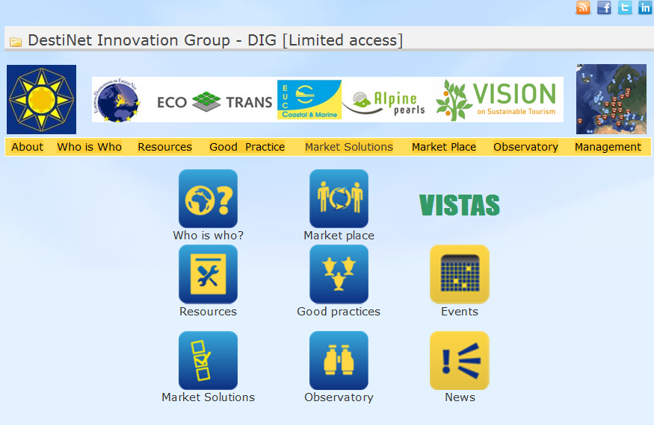
DestiNet Innovation Group
Towards a common toolkit for destinations in Europe
INTRODUCTION
Meeting 12 December 2013 in Bonn
14:00 – 17:00, GNF office

Slide 2

ECOTRANS/DIG: DestiNet for Destinations
➔ 12 Dec meeting: Bringing services and tools together (v2-hh)
TOOLS
SERVICES
GSTC
GSTR
DIG networks
TKIC, Topics info tool
online selfcheck, courses
Ecotrans experts, other
VISTAS
Travelife, Green Globe, CSR Tourism, GKey
Market Place, Atlas of Excellence
GreenHopping, GDV, BookDiff, Tour Op‘s
GSTR, Eye on Earth
Global standard for destinations
European criteria and indicators
Destination types (coastal, etc)
Research, Knowledge networking
Education & Training
Consulting
Awarding
Certification
Market access
Marketing
Monitoring

Slide 3
ECOTRANS/DIG: DestiNet for Destinations
➔ 12 Dec meeting: Bringing services and tools together (v2-hh)
On which TOOLS & SERVICES do you want to be involved as expert or service provider?
EXAMPLE
ECOTRANS MEMBER: Karl Reiner
DestiNet portal to TOOLS & SERVICES
Promote services in Austria
Focal point Austria
Invite destinations, coordinate Austria
Administrator Austria, green mobility
Trainer for DMOs
Consulting destinations in Austria
Promotion, jury member
Austrian list of green proofs, auditor
News feed
Promoting to destinations
Monitoring and report Austria
GSTC for destinations
GSTR criteria and indicators
DIG Self Check
DestiNet knowledge base, solutions
Courses: education and training
„ask expert“ service, consulting
VISTAS Awards
ST Certification
Market Place, promotion
DIG TGE marketing package
Eye on Earth

Slide 4
ECOTRANS/DIG: DestiNet for Destinations
➔ 12 Dec meeting: Bringing services and tools together (v2-hh)
On which TOOLS & SERVICES do you want to be involved as expert or service provider?
ECOTRANS MEMBER: Name
TOOLS & SERVICES
(your keywords
(your keywords
(your keywords
(your keywords
(your keywords
(your keywords
(your keywords
(your keywords
(your keywords
(your keywords
(your keywords
GSTC for destinations
GSTR criteria and indicators
DIG Self Check
DestiNet knowledge base
Courses: education and training
ECOTRANS ask expert, consulting
VISTAS Awards
ST Certification
Market Place, Atlas of Excellence
DIG TGE marketing package
Eye on Earth

